Slide 1
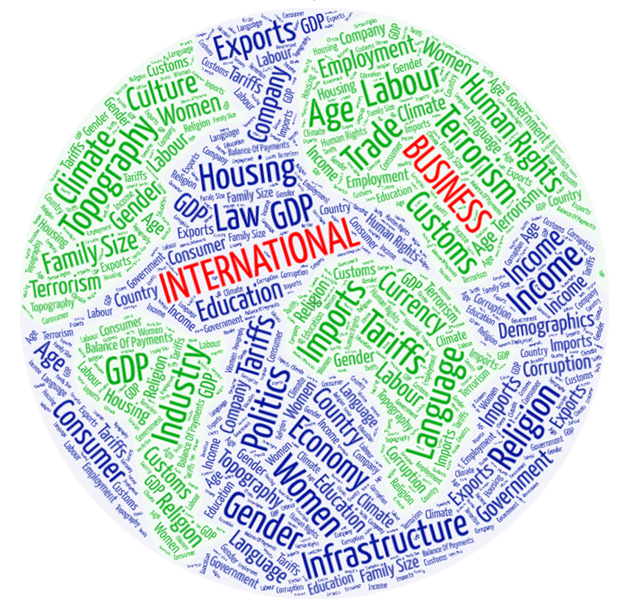
COMMERCE 4SA3
International Business
Ines Perkovic
Business Librarian
perkovic@mcmaster.ca
Mills Library, L101B
2024/25

Slide 2
Session Outline
Key library resources for worldwide information on:
  Countries
  Companies
  Industries
  Consumers
Tips on how to search & access these resources
How to get more help!

Slide 3

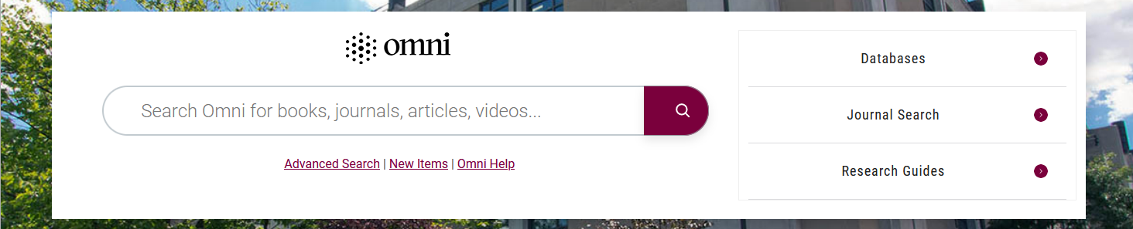
Finding Library Resources https://library.mcmaster.ca/
Omni
Find Articles, Books, Journals, Databases, etc. All formats.
Databases
Find Databases
by Name or
by Subject Area

Slide 4
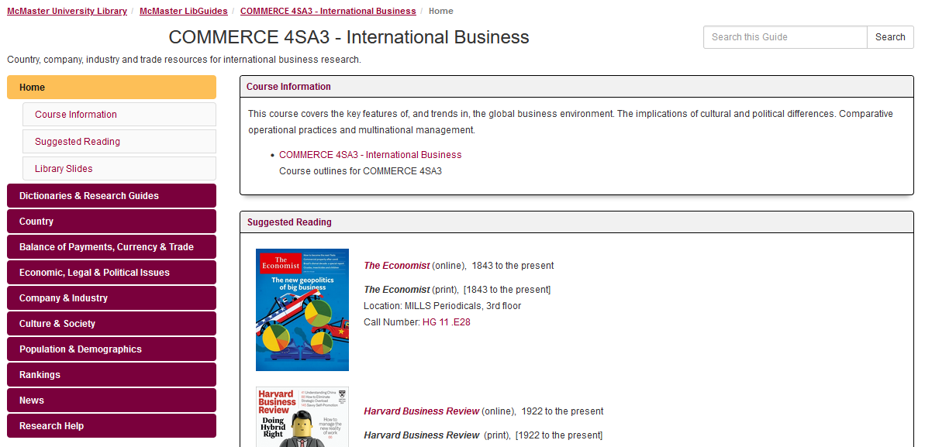
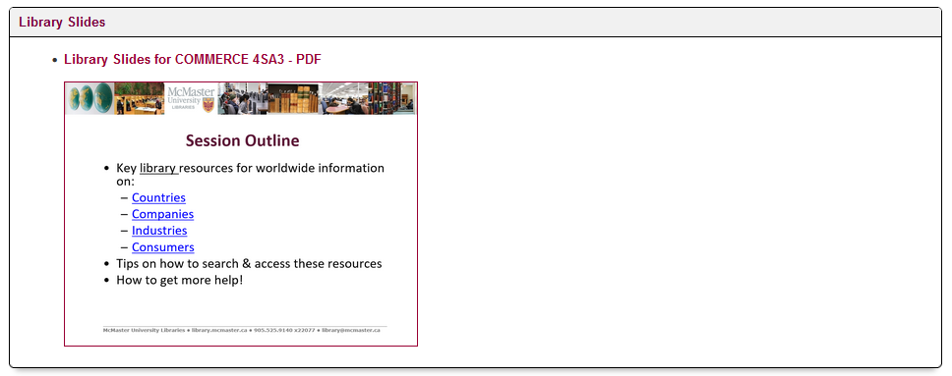
Course Research Guide
International Business & Marketing https://libguides.mcmaster.ca/commerce4sa3
Path to guide: Library home page > Research Guides > Business > COMMERCE 4SA3
Guide includes library resources along with free websites
Links to guide & slides may also be included in Avenue to Learn

Slide 5

Worldwide
Country Info

Slide 6
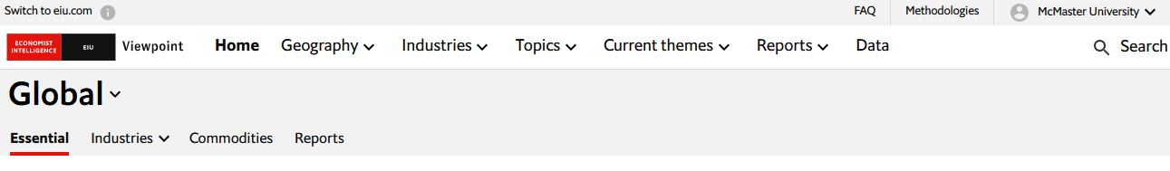
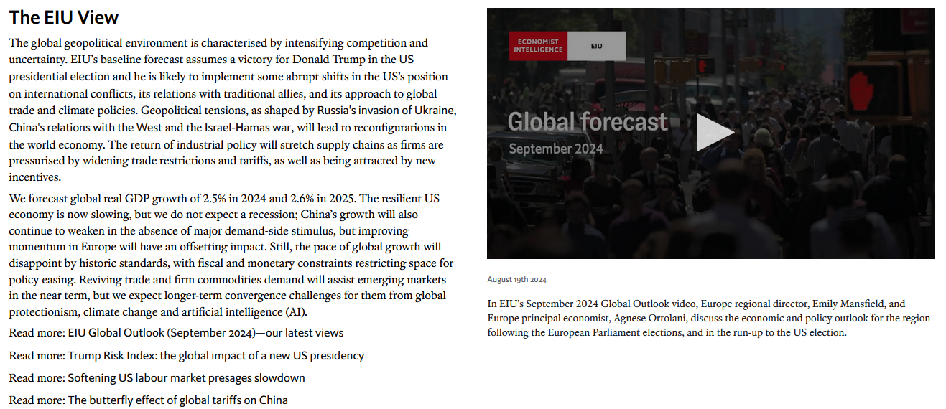
EIU Viewpoint
Contains country specific analysis and data by
The Economist Intelligence Unit (EIU)
Search for keyword(s)
or browse for content using drop-down menus/links
Viewpoint covers the political, policy, business and economic outlook for nearly 200 countries and 26 sectors across six major industries.

Slide 7
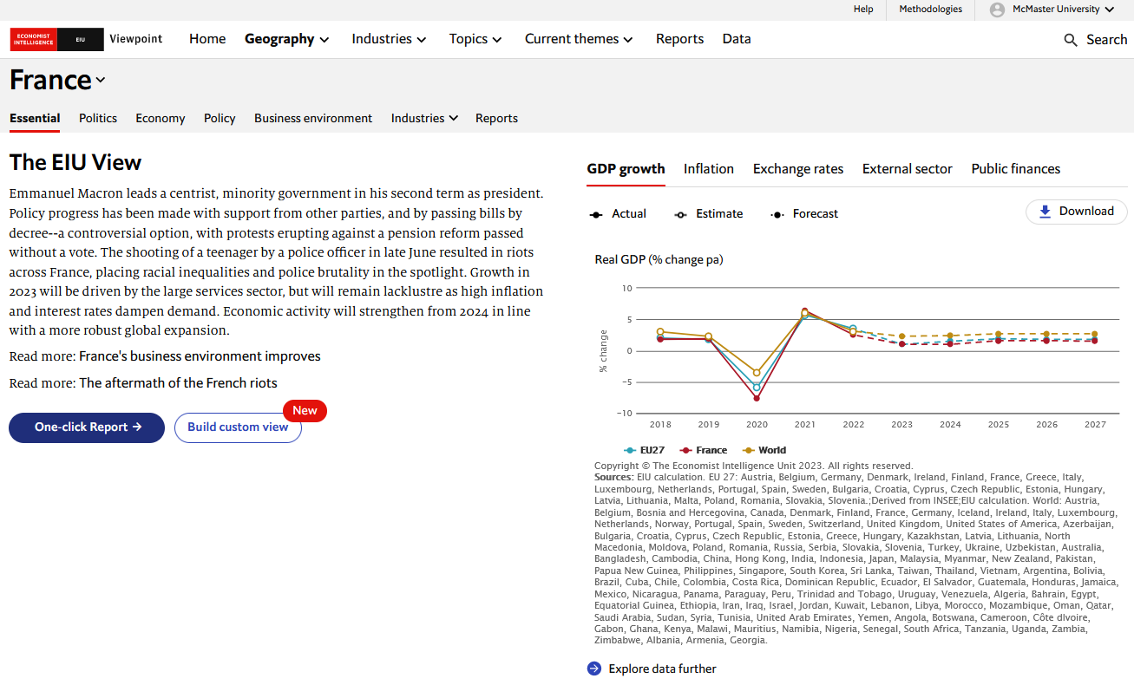
EIU Viewpoint Reports & Data e.g., France selected from Geography menu
Use menus and links to navigate to
desired information
Most countries are updated monthly
Analysis supported with charts &
graphs highlighting key data trends
and forecasts for selected country

Slide 8
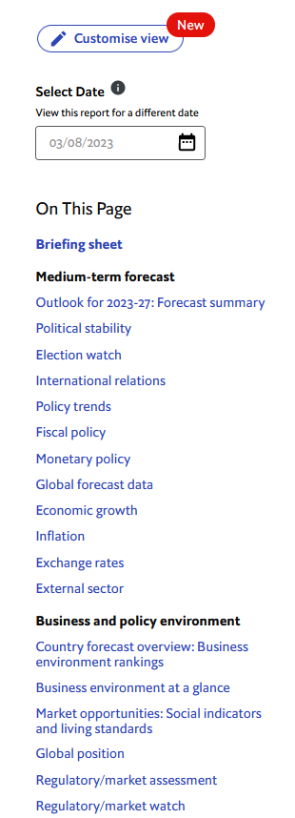


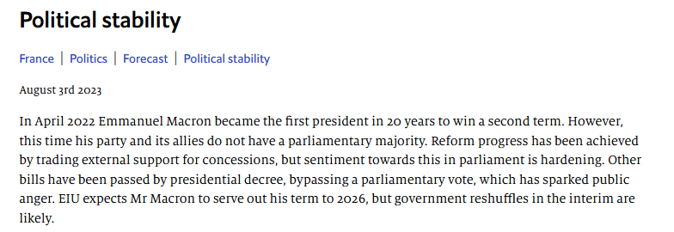
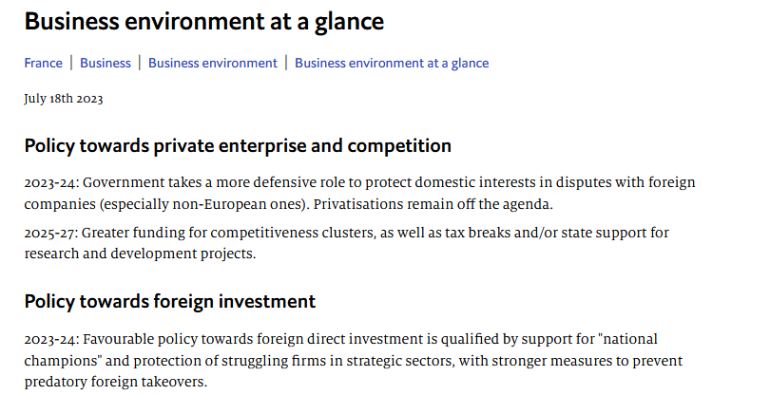
EIU Viewpoint: Report for France
To download a report in PDF format, click the Print button and select Save to PDF.
Notes:
One-click report brings together in a single view all analysis for a geography

Slide 9
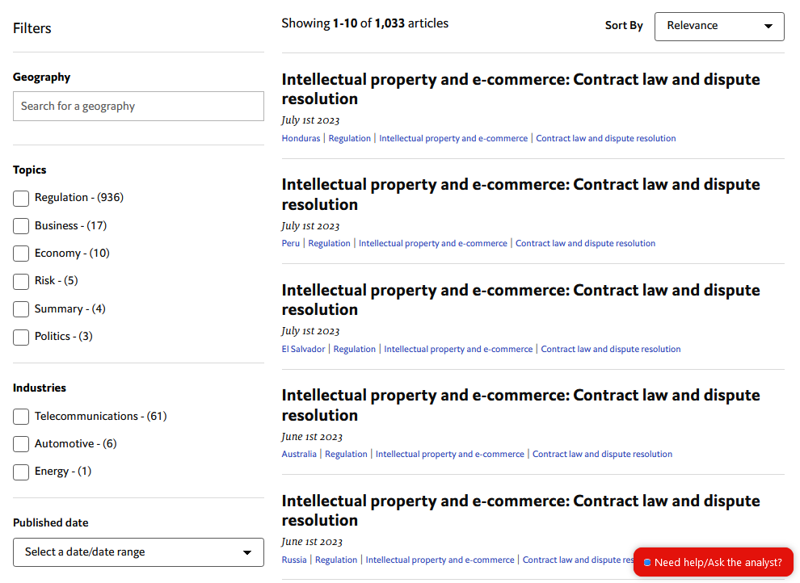

EIU Viewpoint: Sample Search
Can’t find what you’re looking for?
Use Search and input your keywords to find relevant info.
Use Filters to refine search results.
Search Tips
“ ” quotes find items with exact
phrase
* wildcard finds word ending
variations i.e., law, laws,
lawyer, lawless, etc.

Slide 10
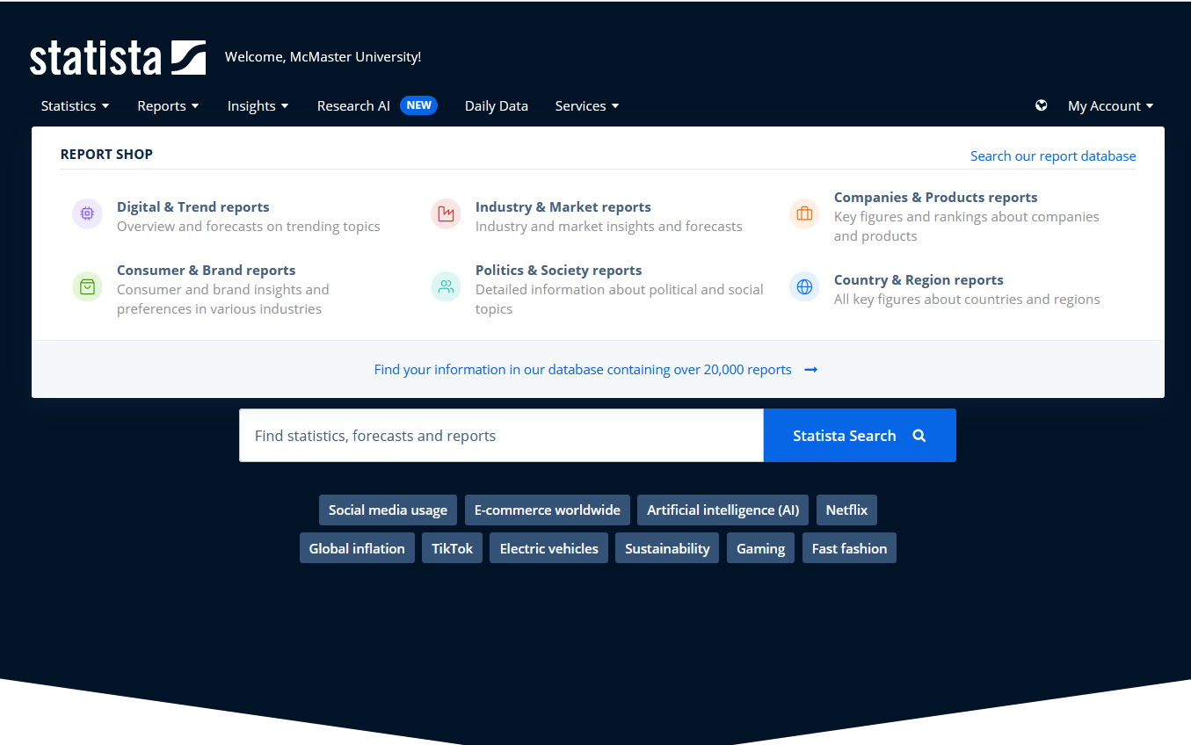
Statista
Includes country reports with data for 150+ countries
Country reports are approx. 50+ pages & typically
Introduction
Country Overview, Business Culture …
Economy
Economic Conditions, Inflation, Employment …
Trade & Investment
Trade in Goods/Services, Tax Policy, Foreign
Direct Investment (FDI) …
Society
Population, Income, Human Development
Health
Health Expenditure, Health Infrastructure …
cover …
Retail & Consumption
Retail Markets, Consumer Spending, Fintech …
Infrastructure
Internet, Transport Infrastructure
Environment
C02 Emission, Energy, Climate Risk …
Politics
Political System, Political Rights, Gov’t quality
Security
Instability/Conflicts, Military Expense
Notes:
Topics covered may vary between country reports. See table of contents for detailed information.

Slide 11
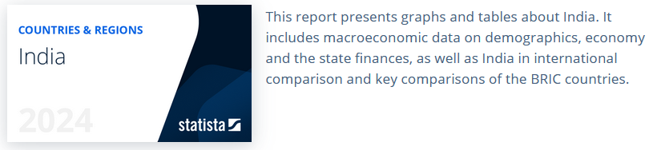
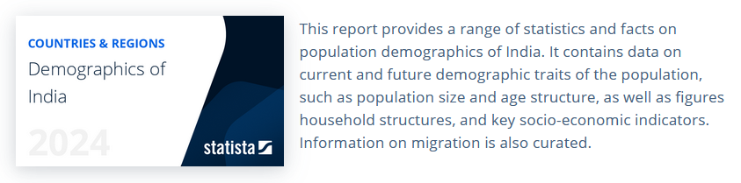
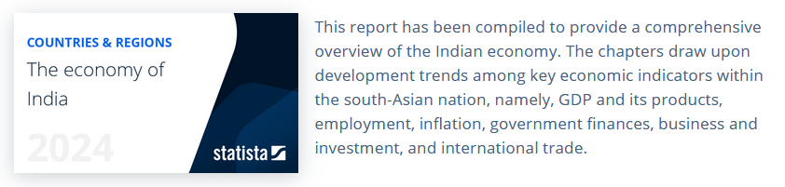
Statista
Sample Country Reports: India
Reports typically available in pptx and pdf formats

Slide 12

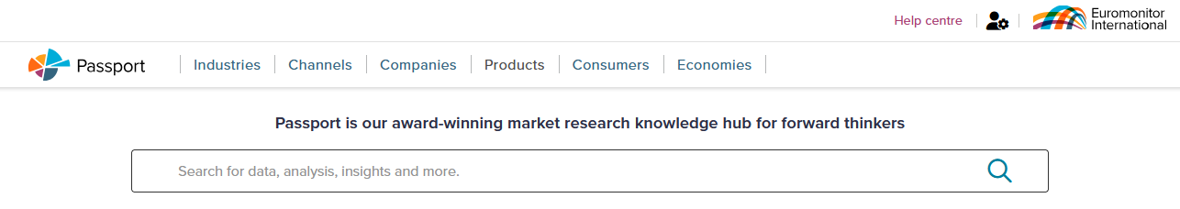
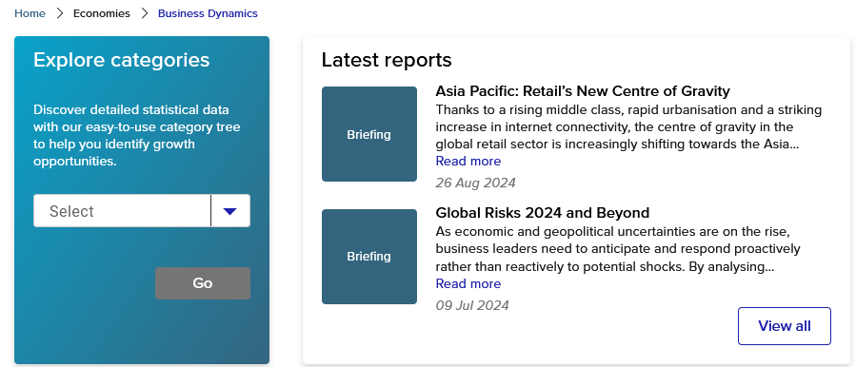
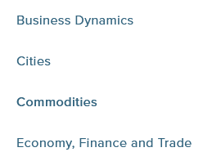
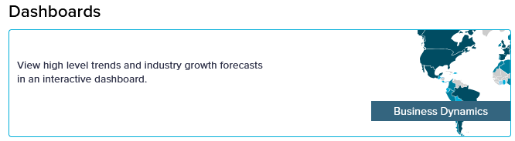
Passport
Statistics & analysis for international countries & cities
Search for keyword(s) or Browse ECONOMIES menus for content (Analysis, Statistics, Dashboards, plus Overviews and Latest Reports)
business dynamics south korea

Slide 13
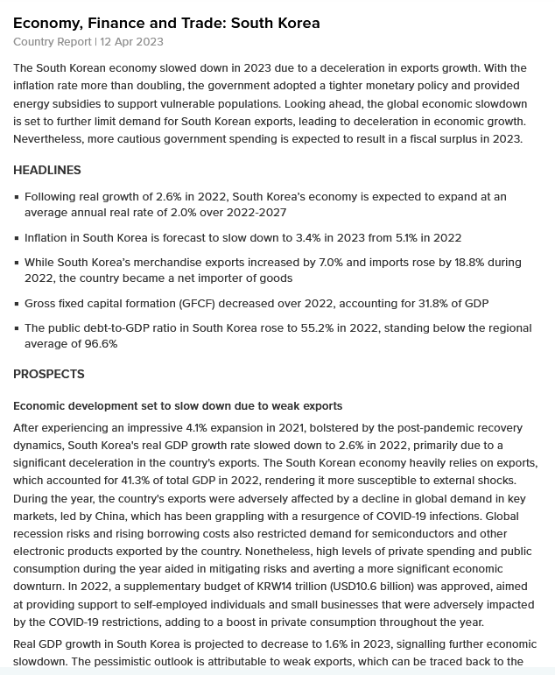
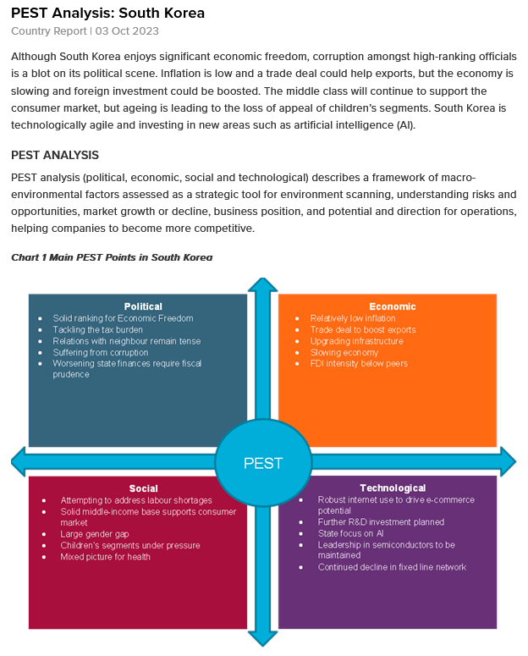
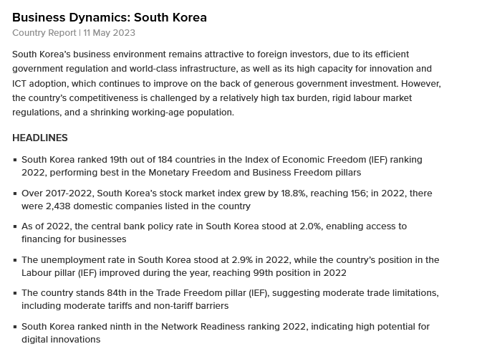
Passport: Sample Country Reports for South Korea

Slide 14
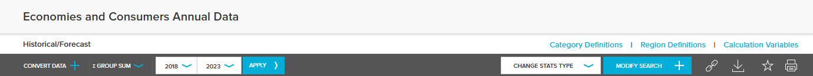
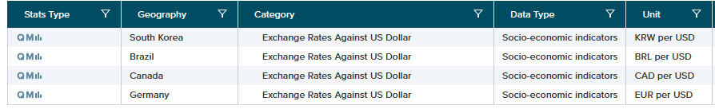
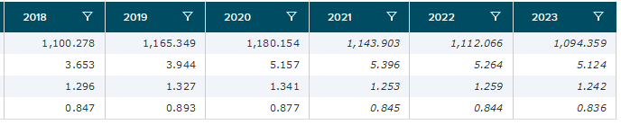
Passport: Sample Statistics e.g., Annual Exchange Rates Against US Dollar
South Korea, Brazil, Canada, Germany
Create customized tables :
Add, Remove or Change Data/Years/Categories/Geography

Slide 15
Worldwide
Company Info

Slide 16
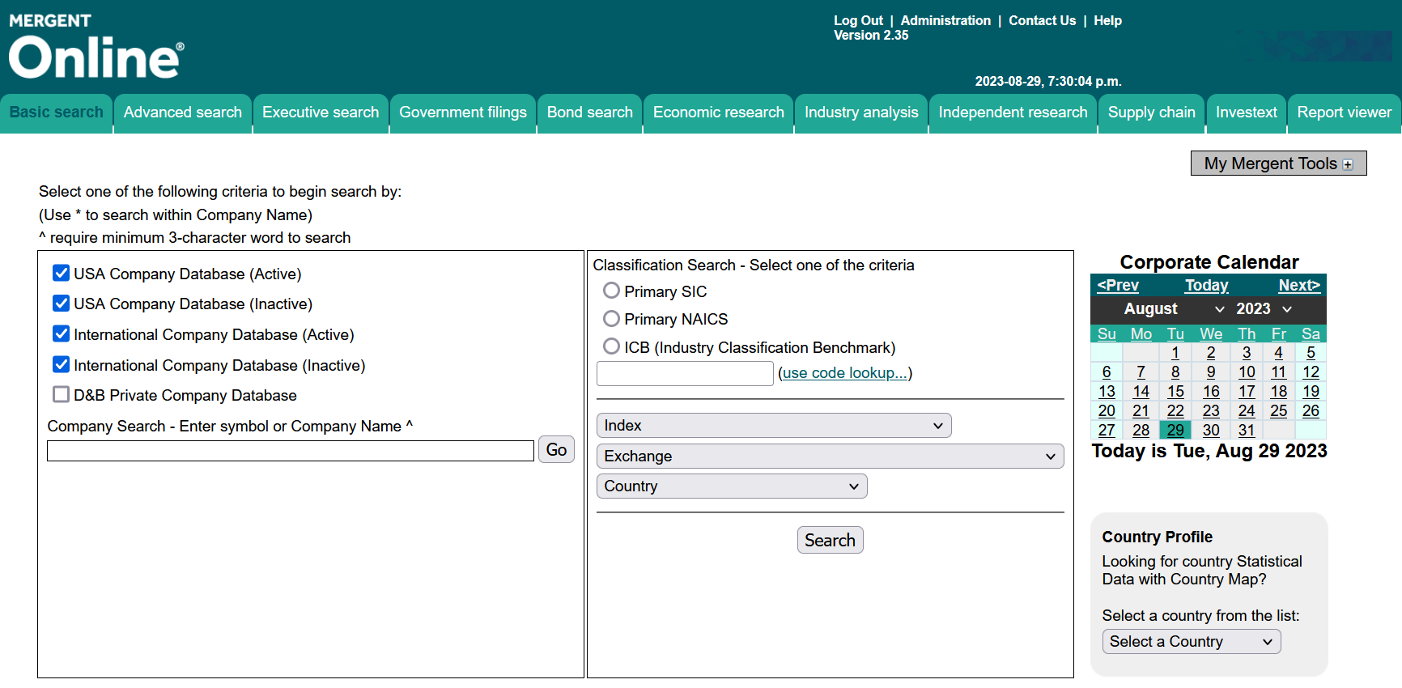
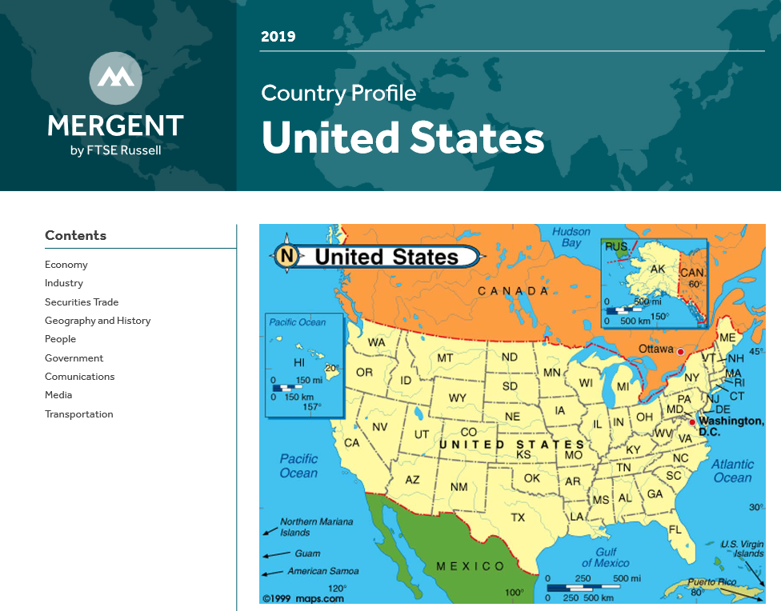
Mergent Online
Corporate & Financial Data for Worldwide Companies
(+ Country Profiles)
Search by company name, country, industry code (NAICS or SIC), and more
Alphabet

Slide 17
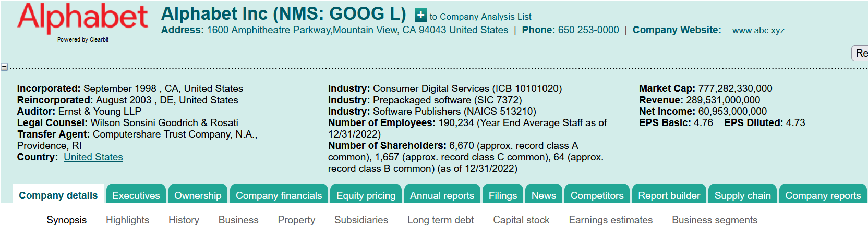
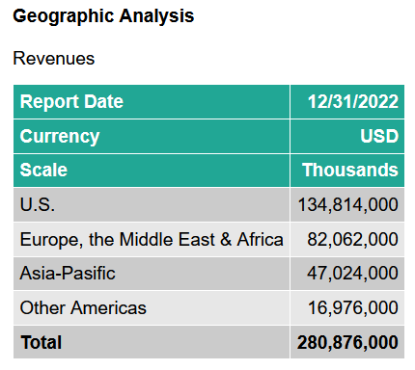
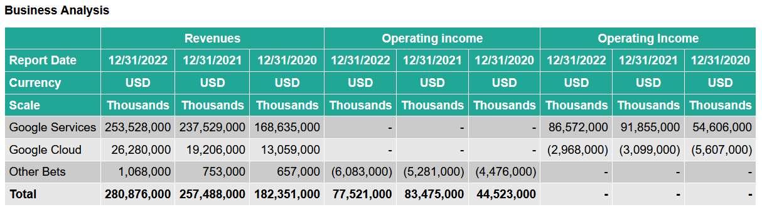
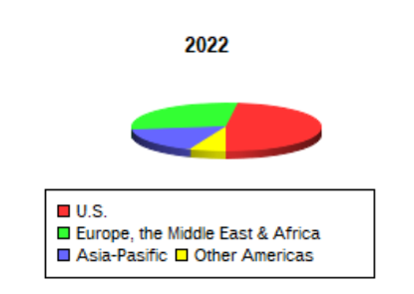
Mergent Online e.g., Company Profile for Alphabet Inc.

Slide 18

Worldwide
Industry Info

Slide 19
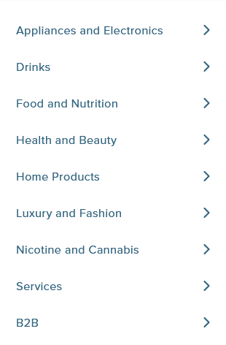
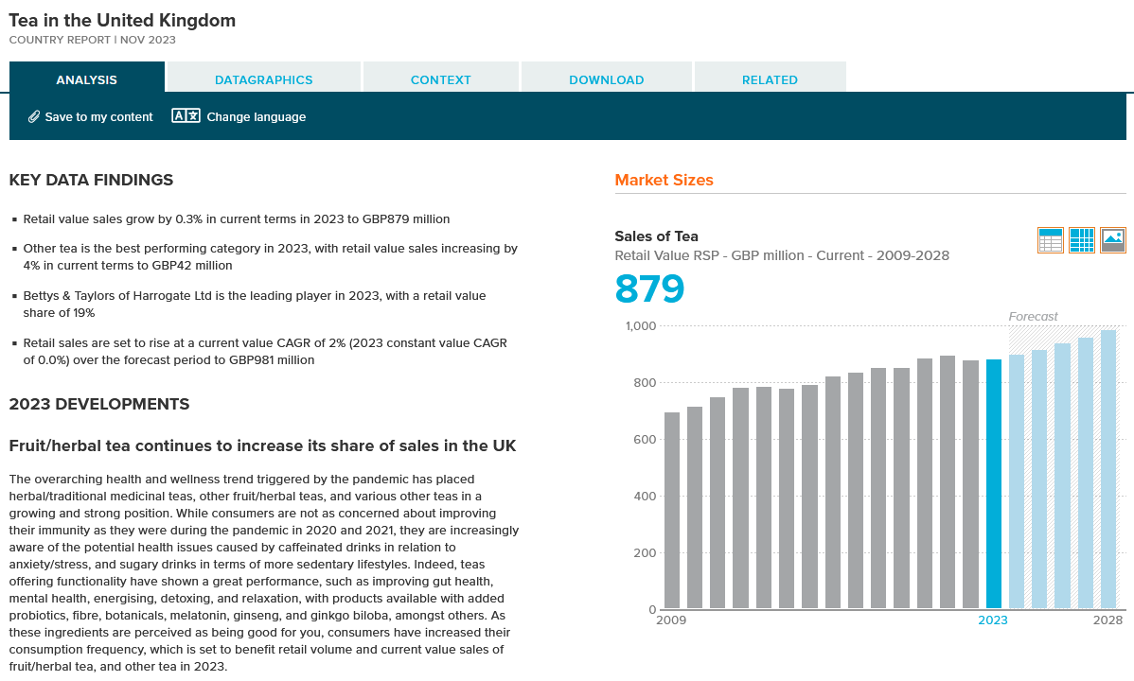
Passport
Worldwide industry info on a variety of consumer goods & services
Search for keyword(s) or Browse INDUSTRIES menus
tea united kingdom
Look for Related statistics and reports to find other potentially relevant information
Each industry category breaks down into narrower topics
e.g., DRINKS includes Hot Drinks which has separate country-specific reports on Coffee and Tea.
Notes:
Each industry will have a separate country report; for example, Eyewear in France, Eyewear in Canada, etc.

Slide 20
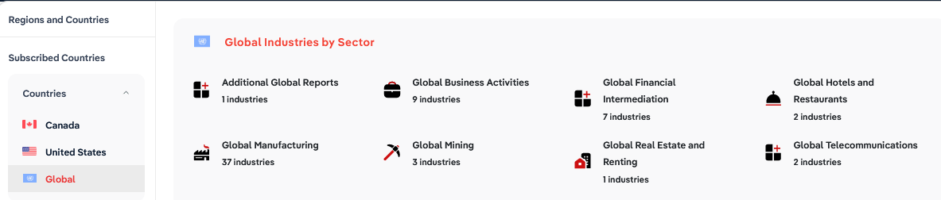

IBISWorld
Global (plus Canadian & US) Industry Reports
global tourism
Covers over 70 industries from a
global perspective
Browse a list of industries or
Search for keyword(s)
Reports are approx. 40 plus
pages long
Reports are updated at
least 1x each year
Global Business Activities (9 reports)
Global Financial Intermediation (7 reports)
Global Hotels & Restaurants (2 reports)
Global Manufacturing (37 reports)
Global Mining (3 reports)
Global Real Estate & Renting (1 report)
Global Telecommunications (2 reports)
Global Transport, Post & Storage (7 reports)
Global Wholesale & Retail Trade (1 report)
Other Global Community, Social & Personal
Service Activities (4 reports)
Additional Global Reports (1 report)

Slide 21
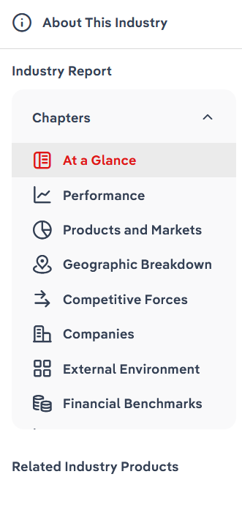
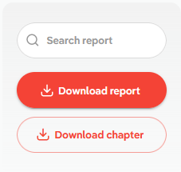
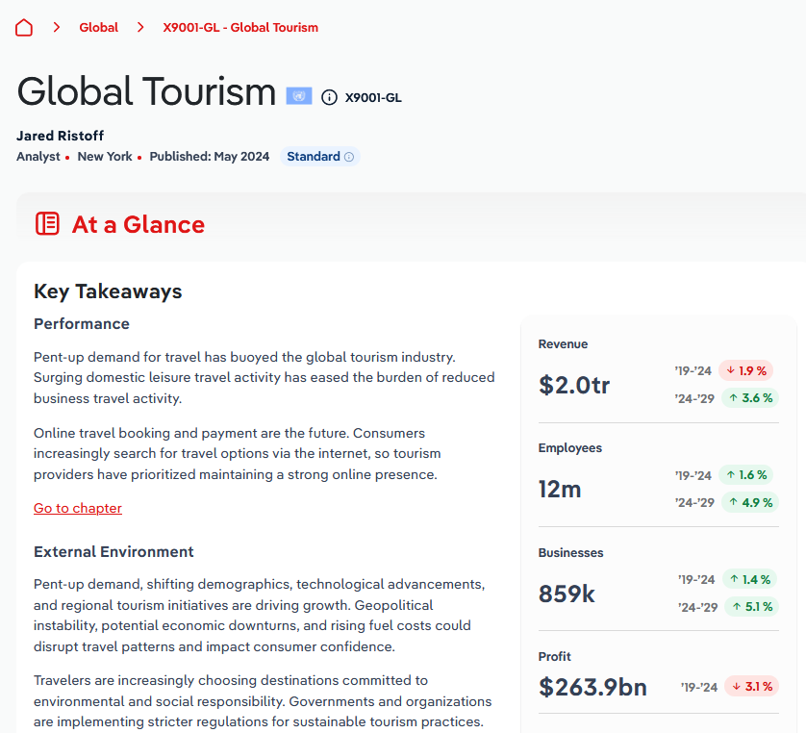
IBISWorld: Sample Report
Typical Table of Contents

Slide 22
Worldwide
Consumer Info

Slide 23
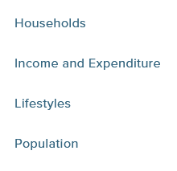

Passport
Worldwide consumer & demographic information
Search for keyword(s) or Browse CONSUMERS menus
consumer lifestyles in australia
Passport includes
individual reports for
over 200 countries
entitled:
Consumer Lifestyles in … [country name]
Consumer Types in …
Consumer Values and Behaviour in …
Megatrends in …
Households: …
Income and Expenditure: …
[country name] In 2040: The Future Demographic
Report typically covers topics such as …
Consumer Landscape
Personal traits and values
Home life and leisure time
Eating and dietary habits
Working life
Health and wellness
Shopping and spending

Slide 24
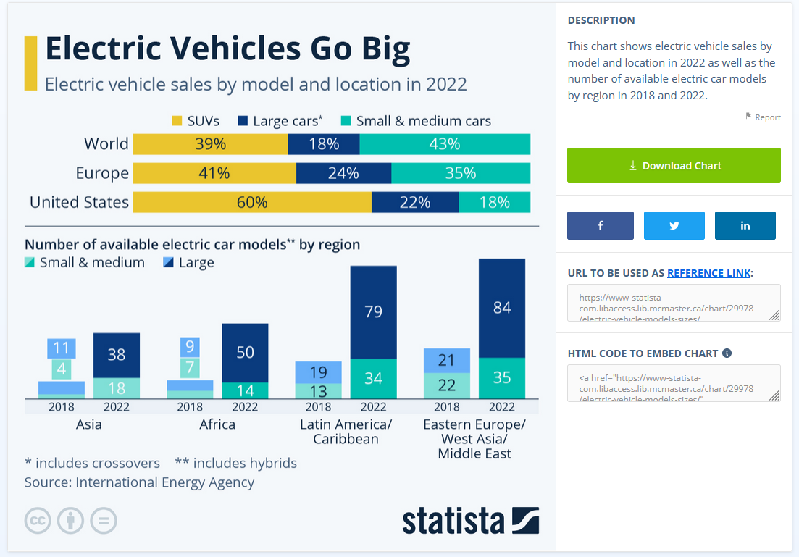
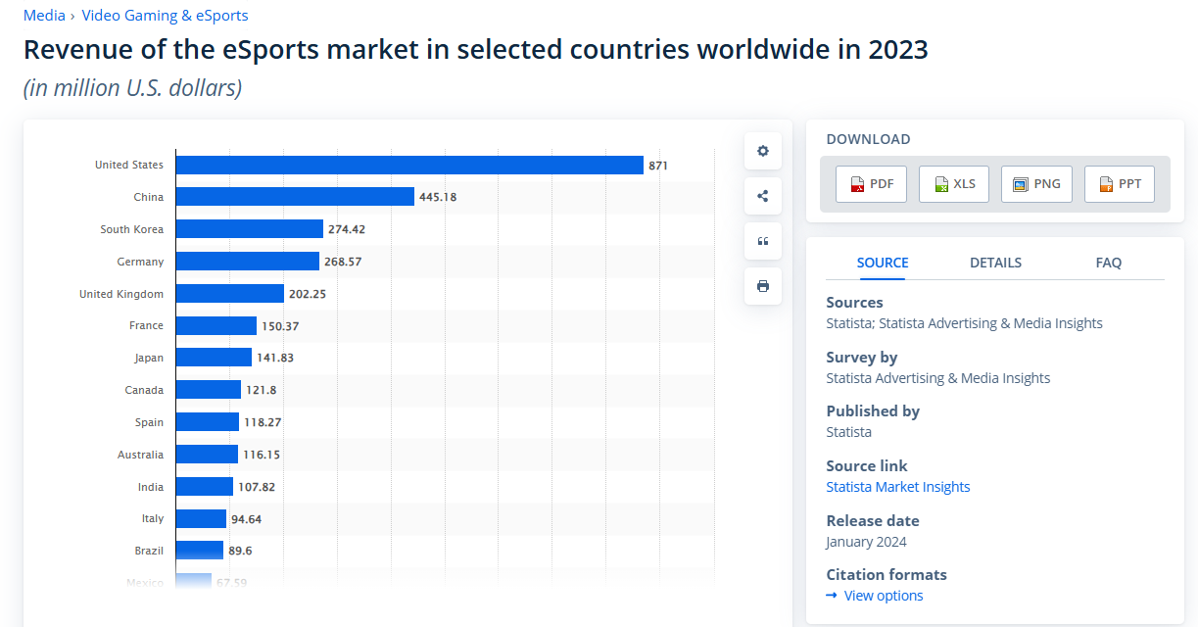
Statista
International statistics on over 80,000 topics from 18,000+ sources.
Sample infographic
and statistical table in Statista

Slide 25





Research Help
E-mail: library@mcmaster.ca
Phone: 905-525-9140
  ext. 22077 Mills Service Desk
In Person:
  Drop by a Library Service Desk
  (1st floor), Monday to Friday or book an appointment
Live Chat/Text: https://library.mcmaster.ca/justask/

