Slide 1
Citing sources
Chicago Style (17th edition): Notes & Bibliography
McMaster University Library
Notes:
Citing sources is an important part of research and writing.
This video will briefly discuss why it is important to cite, when you need to cite, and how to cite your sources using Chicago Style’s notes and bibliography system.

Slide 2
Why cite?
to distinguish your contributions from those of others
to document sources used
to credit authors of the works that you are using
to support your analysis
to put your interpretations into context
to help readers find the sources used
to provide additional sources for further study
to trace your research
to avoid plagiarism
Notes:
A research paper or report will typically include your own ideas and words along with the thoughts and text of other people.
Citing helps distinguish your contributions from those of other authors.
It documents what sources you have used and credits the work of others.
The variety and quality of sources consulted can also lend support, credibility and authority to your analysis and it puts your interpretations into context
Citing your sources also permits a reader to locate, verify and consult the sources used and allows them to explore additional sources for further study.
In other words, it provides a way for you and others to track and trace your research.
If you do not acknowledge the sources that have influenced or appeared in your paper (even if unintentional), you are guilty of plagiarism, a serious offence that violates moral and professional ethics.
Citing will help you avoid plagiarism and protect your academic integrity.
----------------------
Image source: https://tlp-lpa.ca/research/why-cite

Slide 3
When to cite
When the work or idea of another person is …
Quoted
Paraphrased
Summarized
Influential
Notes:
You should cite your sources whenever you refer to them directly or indirectly.
For example, you need to cite when you have …
- quoted a piece of text word-for-word
- paraphrased another person’s ideas or text into your own words
- summarized the main points of someone else’s work
- or been influenced by another work
As you do your research, take careful notes and keep track of your sources so you have all the information you need to cite them properly.
-----------------
Image source: Idil Keysan for the Wikimedia Foundation, CC BY-SA 4.0 <https://creativecommons.org/licenses/by-sa/4.0>, via Wikimedia Commons
https://commons.wikimedia.org/wiki/File:Citation_Needed_-_Idil_Keysan_-_Wikimedia_Giphy_stickers_2019.gif

Slide 4
Citation styles
Purpose:
establishes a standard of writing and documentation within a particular field
uniform style helps readers scan references quickly for key points and findings
encourages full disclosure of essential information
Examples:
APA
MLA
Chicago
Vancouver
Harvard
etc.
Notes:
To help with citing sources, many writing guides and style manuals have been developed for use in various disciplines. Some of the most popular citation styles include APA, MLA, and Chicago.
Although there are numerous citation styles available, they usually require much of the same information.
Most of the differences between styles are related to formatting , punctuation and the order of elements.
Once a style is selected, it should be used consistently throughout your paper.
Since papers can be written in a variety of ways, these citation styles help establish an accepted standard for writing, documentation and formatting within a particular field.
The uniform style establishes a consistency in presentation that helps readers scan references quickly for key points and findings.
It also encourages the disclosure of essential information among researchers and writers.

Slide 5
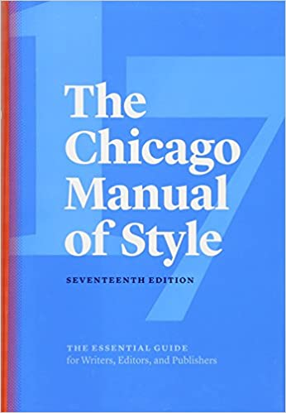
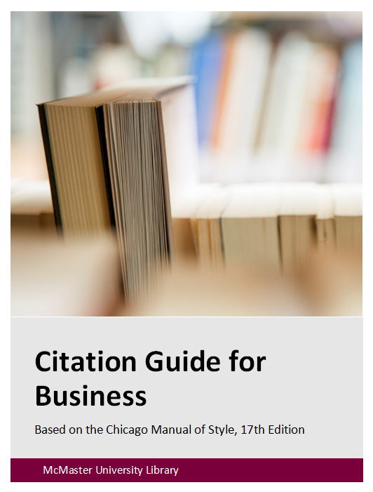
Chicago Style: Notes & Bibliography
Citation Guide for Business includes formatting rules for
Title Page
Contents
Text
Appendix(es)
Notes
Bibliography + citation examples for frequently used sources
Official CMOS 17 (2017)
Citation Guide for Business
Available via University Library website: library.mcmaster.ca
Notes:
In this course you are required to use the Chicago style notes and bibliography system for your reports.
The official Chicago Manual of Style is in its 17th edition and can be accessed online through the Library’s website.
Why Chicago?
Chicago is a citation style often used for reports and scholarly writing in many fields of business, so as a Commerce student it is a style you are likely to encounter frequently in your studies.
All the most relevant Chicago style rules have been summarized and outlined in the Citation Guide for Business, a guide specifically developed for the DeGroote School of Business.
This guide highlights the formatting requirements of all the major components of your paper – the title page, contents, text, appendix, notes and bibliography.
It also includes examples of how to cite a variety of different sources such as books, articles, reports and web pages.
Moreover, it includes citations for some of the most frequently cited sources in this course such as industry classification code manuals.
If your questions are not addressed by the Citation Guide for Business, consult the official manual for Chicago style.

Slide 6
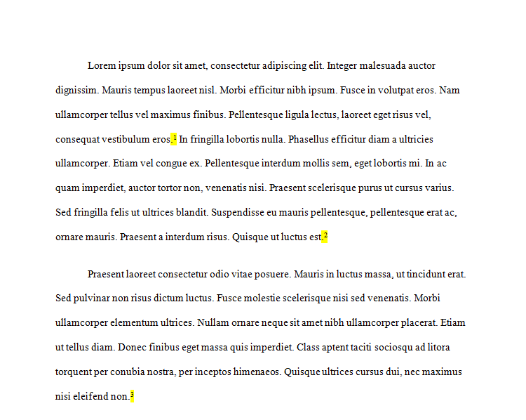
Notes: In-Text + Endnotes
1. Complete endnote form (1st citing)
Text
2. Shortened endnote form (subsequent citing).
Each time a source is used in the text, it must be cited with a superscripted note number.
The specific details of the sources cited in the text will be listed in numerical order on a separate Notes page near the end of the paper (i.e., endnotes)
Notes:
One part of citing involves Notes. In Chicago style, each time a source is used in the text, it must be cited with a note.
This is done with a superscripted number that is placed at the end of a sentence that uses ideas or text from a particular source.
On this slide, in the text image, the note numbers are highlighted in yellow. Note numbers begin with “1” and continue in consecutive order throughout the paper as needed.
The specific details of the sources cited in the text will be listed on a separate Notes page near the end of the paper and are referred to as endnotes.
These endnote citations are arranged in the same numerical order that they are referred to in the text.
A single source can be cited in the text many times and each instance will have its own endnote number.
The first time you cite a source, a full endnote citation should be provided in the Notes list.
If you cite the same source again, a shortened endnote form should be used.

Slide 7
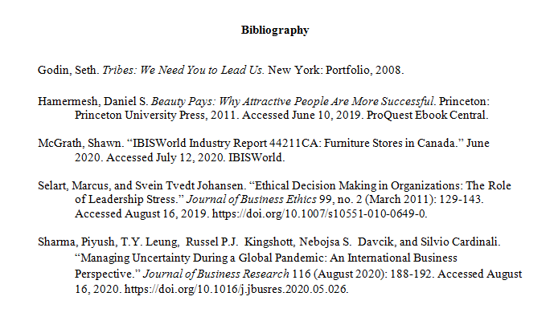
Bibliography
lists all the sources used to write your paper
entries are arranged in alphabetical order according to the first word in each citation (i.e., author’s name, or first word in title if there is no author)
includes a single entry for each source, regardless of how many times it has been cited in the paper
Notes:
The other part of citing involves the Bibliography.
It includes all the sources used to write your paper.
Entries in a bibliography are organized in alphabetical order according to the first word in each citation
Furthermore, only a single entry is included for each source, regardless of how many times it has have been cited in the paper

Slide 8
Endnote & Bibliography Differences
ENDNOTE
BIBLIOGRAPHY
1. Ken Auletta, Googled: The End of the World As We Know It (New York: Penguin Press, 2009), 10.
Auletta, Ken. Googled: The End of the World As We Know It. New York: Penguin Press, 2009.
first line of each entry flush to left margin, with subsequent lines indented (i.e., hanging indent)
author (inverted): surname, given name
periods separate citation elements
specific location in source not included
first line of each note indented, with subsequent lines flush to left margin
author: given name, surname
commas separate citation elements
specific location in source included (e.g., page)
Notes:
You may have noticed that endnote and bibliography citations are formatted a bit differently.
Although both types contain a lot of the same information about the source, it’s the small details in these citations, like punctuation, that vary.
For instance, the top of this slide includes an example of a book citation.
In the endnote, the citation is indented on the first line, the author’s given name precedes the surname, commas are used to separate citation elements, and the page number where the information was found is noted.
In the bibliography, the citation uses hanging indents, inverts the author’s name, uses periods to separate citation elements and excludes the page number altogether.
Although these differences may seem minor, they do matter, so it’s important to pay close attention to them as you create the citations for your paper.

Slide 9
Citation Elements & Source Types
Book citations require ...
Name of Author(s)
Book Title [in italics]
Place of Publication
Publisher
Publication Date
URL/DOI & Access Date (if online)
Journal article citations require ...
Name of Author(s)
“Article Title” [in quotes]
Journal Title [in italics]
Volume
Issue
Page Number(s)
Publication Date
URL/DOI & Access Date (if online)
Citation Guide for Business
identifies all the citation elements (& formatting) required by Chicago style for a variety of sources (e.g., articles, books, images, podcasts, reports, videos, web pages, etc.)
also includes endnote and bibliography examples for each source type!
Notes:
The information needed to construct citations depends upon the type of source being used. In other words, citations to books require different citation elements than journal articles and blog posts.
For example, book citations need an author, title, place of publication, publisher and a publication date. If online, a link and access date are also required.
By contrast, journal article citations need a bit more information including an author, article title , journal title, volume, issue, page numbers, and publication date. If online, a link and access date are also needed.
So before you can cite something correctly, you'll need to identify the type of source you are using.
Once you do, all the rules for putting together that citation will be noted in the Citation Guide for Business. Endnote and bibliography examples are also provided for each source type.
--------------------------
Image sources:
Book cover of: Cialdini, Robert B. Influence: The Psychology of Persuasion. ‎Revised ed. New York: Harper Business, 2006.
https://images.squarespace-cdn.com/content/v1/568cf1da4bf1182258ed49cc/1528511290602-OAXZOM8IT25H9LFVEFU1/Screen+Shot+2018-06-09+at+12.27.30+PM.png
First page of PDF journal article from Taylor & Francis website:
Dhaliwal, Amrita, Devinder Pal Singh, and Justin Paul. “The Consumer Behavior of Luxury Goods: a Review and Research Agenda.” Journal of Strategic Marketing (June 2020): 1–27. Accessed January 15, 2023. https://doi.org/10.1080/0965254x.2020.1758198.

Slide 10
Get HELP
E-mail: library@mcmaster.ca
Phone: 905-525-9140
ext. 21359 Business Librarian
ext. 22077 Mills Service Desk
Face to Face:
Drop by Mills Service Desk (1st floor), Monday to Friday or book an appointment
Live Chat/Text: https://library.mcmaster.ca/justask/
Notes:
So there you have it. A brief summary of the notes and bibliography system in Chicago style.
Should you have any questions about citing, please don’t hesitate to get in touch with the Library via email, phone, face to face or live chat.
Happy citing!

