Slide 1
Research Resources for
Introduction to Marketing https://library.mcmaster.ca
Ines Perkovic
Business Librarian
McMaster University Library
Notes:
Welcome. ​
​
This Library session will focus on the research resources that will help you complete the reports specifically required for your Introduction to Marketing course​.
​
The resources discussed should also prove useful for other Commerce courses you

Slide 2
During this session, you will learn …
How to find and use industry codes
Identify companies and competitors in an industry
How to find company info
How to track down market share data
How to find industry info
Cite all the stuff you find
Get more help!
Notes:
During this session, you will learn how to find all the key components required for the reports in this course.
This includes …
how to find and use industry codes
how to identify companies and competitors in an industry
how to find information about a company
how to track down market share data and
how to find industry info
We’ll also touch on how to cite all the resources you find and how to get more help if you have any questions.

Slide 3
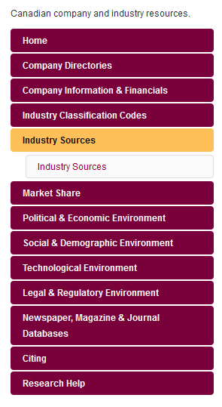
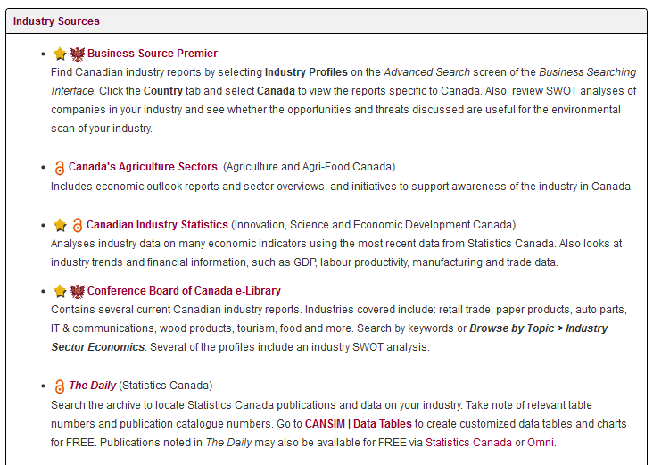

Library Home Page > Research Guides > Business
Pick relevant course research guide from list
Navigate to different sections of the guide using
links on the left.
You will be prompted for your MacID@mcmaster.ca
(Office 365 login) when accessing the Library’s
subscription resources.
This and other business research guides available here: https://libguides.mcmaster.ca/sb.php?subject_id=130212
Notes:
Before we begin, know that all the resources discussed in this session are listed and accessible from a research guide that the Library has prepared specifically for this course.
It includes both open access and subscription resources that you can connect to with your MacID anytime, anywhere.
Remember that subscription resources should always be accessed through the Library’s website to ensure you are properly authenticated and to ensure you get full access to the Library’s licensed content.

Slide 4

What is an
Industry Classification Code?
a hierarchical numbering scheme used to classify and organize industries
assigned to companies engaged in the same activity (regardless of size or type of ownership)‏
Notes:
Let’s start with industry classification codes, something you’ll be using fairly frequently when doing business research.
An industry classification code is a hierarchical numbering scheme used to classify and organize industries.
Industry codes are assigned to companies engaged in the same activity regardless of size or type of ownership

Slide 5
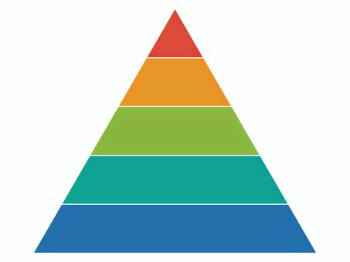
Hierarchical Arrangement
The longer the code number, the more specific the industry
31-33 Manufacturing [sector]
311 Food Manufacturing [subsector]
3113 Sugar and Confectionary Product Manufacturing [industry group]
31134 Non-Chocolate Confectionary Manufacturing [industry]
311340 Non-Chocolate Confectionary Manufacturing [national industry]
315 Apparel Manufacturing [subsector]
322 Paper Manufacturing [subsector]
Notes:
Industry classification systems group industries according to a hierarchy or various levels.
At the top of the classification scheme are industry sectors such as Agriculture, Manufacturing, and Retail.
Sectors are typically broad categories that are represented by a two digit code.
In this example, the manufacturing sector is represented by the digits 31 to 33.
Each sector is then broken down into more granular levels.
The more specific the industry activity, the longer the industry code number.
In this slide we can see that food manufacturing is a subsector within the manufacturing sector and is represented by the digits 311.
Other subsectors within the manufacturing sector will begin with the same digit, the number 3, but will be followed by other digits to denote a different activity.
For instance, 315 represents the Apparel manufacturing subsector and 322 stands for the Paper manufacturing subsector.
As the activity gets more specific, the industry code number will get progressively longer, sometimes extending to 6 or more digits.
In this slide, we’ve drilled down to a 6-digit code - 311340 - which represents the Non-Chocolate Confectionary Manufacturing industry.

Slide 6

Codes Include Industry
Description & Examples
311340 Non-Chocolate Confectionary Manufacturing ‏
This Canadian industry comprises establishments primarily engaged in manufacturing non-chocolate confectionary.
Examples:
  candy (except chocolate), manufacturing
  chewing gum, manufacturing
  marshmallows, manufacturing ...
Exclusions:
  roasting, salting, drying, cooking or canning nuts and
  seeds (see 31191 Snack food manufacturing)…
Notes:
In addition to the industry code number and the formal industry name, an industry classification system will also provide a description of the industry.
The entry usually provides a definition, along with examples of the activities that are included and excluded from that industry.
It this example, a company that manufactures candy (like jellybeans & gummy bears) could be classified in the non-chocolate confectionary manufacturing industry.
A company doesn’t have to manufacture all the example activities noted in the description, just one of them to be included in this industry.
If the same company also produces items excluded from this industry (such as salted nuts), it could be assigned an additional industry code such as 311910 for Snack food manufacturing.
In other words, one company can be engaged in many different industries and have several different industry codes.

Slide 7


Codes Apply to All Types of Companies
5942 Retail Books
This industry includes both major companies (e.g., Indigo) as well as local independent booksellers (e.g. King W. Books)- because both entities are engaged in the same activity
Notes:
Industry codes apply to all types of companies - they can be large or small; they can be privately held or publicly traded – company size and type of ownership doesn’t matter when it comes to assigning industry codes.
Companies engaged in the same activity can be classified in the same industry.
In this example, a large, publicly traded company like Indigo and a small, private, independent business, like King W. Books in Westdale, both sell books, so they would both be classified in the same industry – which in this case is - 5942 Retail Books.

Slide 8

Who Creates the Codes?
Created by government statistical agencies
No central agency assigns the codes to companies
Notes:
Industry classification codes are usually created by government agencies like Statistics Canada.
Although governments will develop the classification system, they do not assign the codes to companies.
There is no central agency that does this activity which means there can be some variation and inconsistency in the codes that companies are assigned.
Different people may interpret the activities of a company differently so the same company can have several codes.
This issue will be illustrated with examples in the upcoming slides.

Slide 9

Who Uses Industry Classification Codes?
Businesses
Academics & Researchers
Government
Policy Analysts
Notes:
Industry codes are used by people in a wide variety of fields including business, education and government.
You won’t just be using theses code for your academic course work, but for research in the workplace as well.
9

Slide 10

Why are the Codes Created?
To overcome language barriers (use numbers instead of words)
To provide precise and official industry names and descriptions
To gather and collate information on industries
To identify key competitors
Notes:
Why are the codes created?
Primarily, to standardize and facilitate the way we communicate about industries.
The industry codes …
can overcome language barriers
provide precise and official industry names and descriptions
can help gather and collate information on industries
can be used to identify competitors

Slide 11

TWO Most Common
Industry Codes Used in Canada
SIC (Standard Industry Classification)‏
  Usually produced by and for a single country
  Codes are only 4 digits long - not much detail
  Poor coverage of new technology
  No longer updated
NAICS (North American Industry Classification System)‏
  Jointly produced by Canada, U.S. and Mexico
  Codes 6 digits long instead of 4 – more detail
  Much better coverage of new technology
  Updated every 5 years
Notes:
The two most common industry classification systems in Canada are the SIC or Standard Industry Classification and the NAICS the North American Industry Classification System.
The SIC code is no longer updated and dates back to the 1980s which means it doesn’t cover new technology – like telecommunications – very well.
SIC codes can be up 4 digits long which does not allow for a lot of granularity.
SIC codes were replaced in the 1990s by the NAICS code.
Instead of having a separate SIC system for different countries, it was decided that Canada, the United States, and Mexico would develop a shared industry classification system for North America called NAICS.
NAICS is updated every 5 years so it does capture modern technologies and new industries.
NAICS codes can be up to 6 digits long permitting for more detail and specificity.

Slide 12

Everyone must be using NAICS by now…
Right?
Reality:
Some of the biggest names in competitive intelligence continue to use the old SIC codes.
Costs too much money to switch research databases over to newer code
Notes:
Although NAICS codes were created to replace SIC codes many current resources still use the old SIC codes.
Publishers who produce company directories and research databases don’t always want to make the switch for cost reasons, so you will encounter both codes in your research.
As such, it’s good to be aware of both SIC and NAICS codes, as you may have to use both to retrieve information about your industry or company.

Slide 13

Bottom Line for Students in this Course
Must include the Canadian NAICS code in your reports
Must find the relevant Canadian 6-digit NAICS code for your industry
Notes:
In this course, you are expected to find a 6-digit NAICS code for the industry that you want to focus on in your reports.
The code you pick will dictate how you discuss the industry in your reports.
-----------------
Image source:
https://www.publicdomainpictures.net/en/view-image.php?image=161503&picture=judge-gavel

Slide 14

NAICS Canada Manual
Revised every 5 years:
  2022 NAICS IS the most recent edition
  use NAICS 2022 Version 1.0
  via Statistics Canada
Use the 6-digit NAICS code & description from this manual for your reports.
Canada
2022
Notes:
So how do you find your NAICS code?
For this course, you are expected to use the latest North American Industry Classification System produced by Statistics Canada, which is NAICS 2022 version 1.0.
You must find the 6 digit NAICS code and description from this manual for the industry you decide to focus on in your reports.

Slide 15
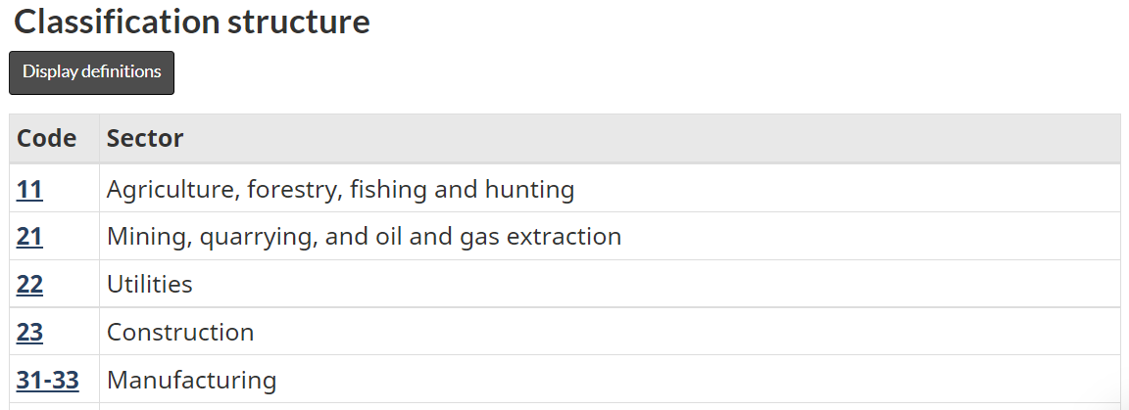
NAICS Canada Online
Example: Beer Brewing
Step 1: Key in your industry words in the search box
SEARCH
BROWSE
Notes:
These next few slides illustrate how to find a NAICS code using the NAICS Canada manual at the Statistics Canada website.
The site allows you to browse for an industry using the classification structure or you can search for keyword(s) to locate your industry code, name & description.
In this example, I’m going to search for the beer brewing industry. To find the relevant code, I simply enter a keyword that describes my industry – in this case the word beer.

Slide 16
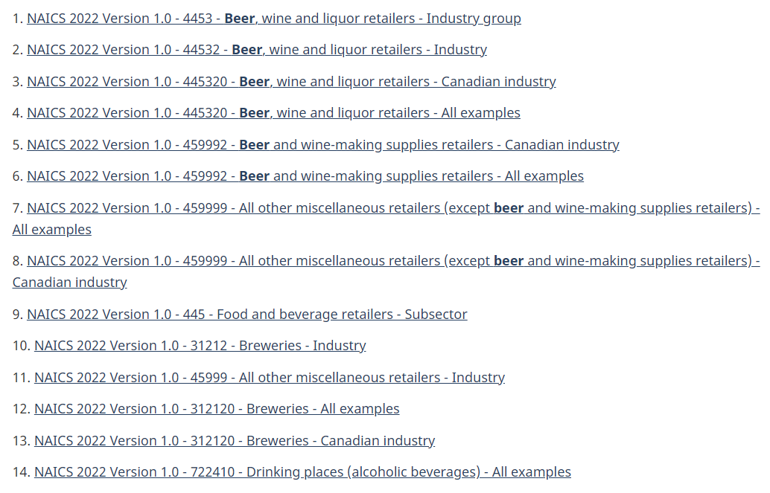
NAICS Canada Online
Example: Beer Brewing
Step 2: In the search results list, click on the relevant link for the full industry name & description.
Notes:
The search results display entries that include the word beer.
Keep in mind that you are searching the entire industry classification system, so review the results carefully and make sure you pick a link with 6 digits and one that falls in your sector of choice.
For this example, I’m interested in beer making, so I would avoid results that are retail oriented such as 445320 Beer, wine and liquor retailers
The result that seems most relevant for beer brewing is 312120 Breweries.
Now you may be tempted to stop here, but in order to get the complete details about this industry, you need to select the link to view the full entry.

Slide 17
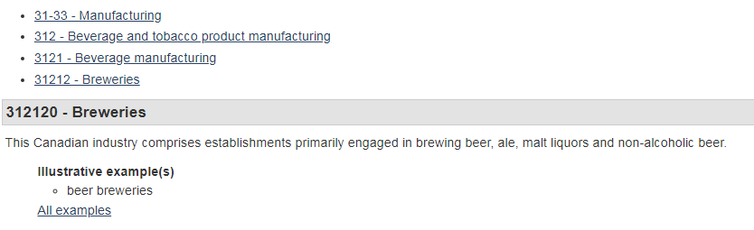
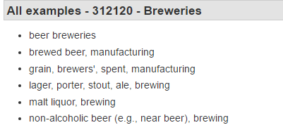

NAICS Canada Online
Example: Beer Brewing
Step 3: Review the definition & description of the industry (including exclusions)
Breweries - formal industry name
Description of Industry
312120
NAICS code
6 digit level
Notes:
This slide is an excerpt of the full entry for this industry.
It turns out that 312120 is the 6-digit NAICS code.
Breweries is the official, formal name for this industry.
The description, along with examples and exclusions are presented.
Any establishment engaged in brewing beer, ale, malt liquors and non-alcoholic beer could be assigned this industry code.
The information in this NAICS code entry will specify how you discuss the industry you choose for your course reports.

Slide 18
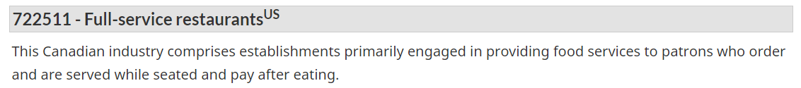
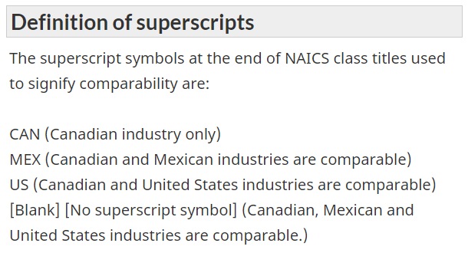

Industry Names with a Superscript
CAN, MEX, or US
It's okay to use a NAICS code which has a superscript CAN, MEX or US.
For example,
All the codes are Canadian, but some are more comparable with the US and/or Mexico.
Notes:
When you use the NAICS Canada manual, you may encounter an industry with the superscript CAN, MEX or US.
If you see US, it simply means that the Canadian and United States industries are comparable.
All the codes in the manual are Canadian, just some are more comparable with the US or Mexico.
As long as the 6-digit code you find comes out of the NAICS Canada manual, you can use it for this course.

Slide 19

WARNING: Read carefully!
EXAMPLE ONE: Group wants to do shoe manufacturing, but select a code for shoe stores!
EXAMPLE TWO: Group wants to do cellular phone manufacturing, but select a code for telephone manufacturing (which excludes cellular)‏
RESULT: Both groups submit
incorrect codes AND incorrect
lists of competitors!
Notes:
It’s also important to read the descriptions in the manual carefully because you don’t want to pick the wrong one and submit incorrect codes and lists of competitors.
For example, shoe manufacturing and shoe stores are two different industries with two very different codes, as are telephone and cellular phone manufacturing.
It’s very easy to fall into the wrong category, so read the definitions carefully.

Slide 20

Can Your Group do a “Piece” of a Code?
NO, you must do the ENTIRE code
EXAMPLE:
  You can’t do “basketballs”.
  You must do “sporting and athletic goods” which includes basketballs, hockey sticks and fishing rods!
Notes:
A lot of people want to do a piece of the code, but for this course you need to do the whole industry as it’s defined by the 6-digit NAICS code.
For instance, if you were interested in basketball manufacturing you would discover that it doesn’t exist as its own industry in NAICS – it’s part of the Sporting and athletic goods manufacturing industry which does include basketballs, but also hockey sticks, fishing rods and other equipment.
You need to talk about the whole industry as its defined by the NAICS code at the 6-digit level, not just one part or piece of the industry.

Slide 21

Choosing the Right Industry
  Industry selected should be Business to Consumer (B2C)
  Choose an industry that will allow you to complete a PESTEL analysis (i.e., at least one opportunity & one threat for each environment)
Notes:
Since this course is primarily focused on the consumer, you are expected to select an industry that centres on business-to-consumer or B2C activities.
In other words, do not pick an industry that is focused on business-to-business or B2B activities such as wholesaling.
Pick an industry that sells or produces a good or service available to the average consumer or shopper.
You should also pick an industry that will allow you to complete a PESTEL analysis. In your report, you will be required to identify at least one opportunity and one threat for each environment in a PESTEL – what political, economic, social, technological, environmental and legal factors are affecting or impacting your industry.
Before you settle on an industry, you may want to do some preliminary research on it to ensure that you can find enough information to complete the PESTEL portion of your report.

Slide 22
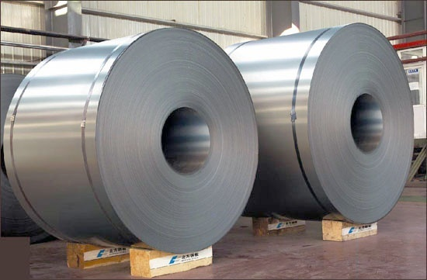

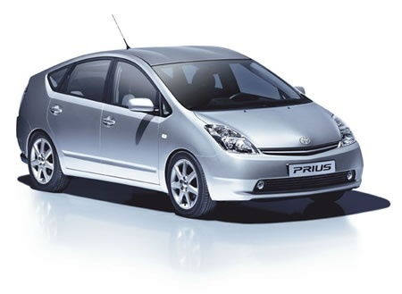
Can I Do a Manufacturing Industry?
YES, as long as the end product that the industry generates is consumer oriented.
The industry does not have to sell directly to the consumer, but it should be a consumer product.
Ask yourself, have I bought this product lately?
Notes:
Some students are unsure if they can do a manufacturing industry for this course because they think it may be too removed from the consumer.
The truth is you CAN do a manufacturing industry as long as the end product that the industry generates is consumer oriented.
The industry does not have to sell directly to the consumer, but it should be a consumer product.
For example, an industry that produces rolled steel wouldn’t be appropriate for this course since individual consumers don’t typically buy this product.
Consumers do purchase vehicles made of rolled steel, so automobile manufacturing would be a permissible manufacturing industry in this course.
If you’re not sure about the suitability of your industry, ask yourself, have I bought this product lately?
If you have, chances are it’s okay to do that industry for this course.

Slide 23
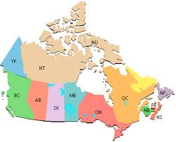

Choosing the Right Industry
The product (good/service) that is produced by this industry must be marketed (i.e., sold) in Canada - although not necessarily made in
Canada
There must be at least three competitors in this Canadian industry; therefore, no monopolies! Companies do not have to originate in Canada, but they do have to do business in Canada
Notes:
Another thing you need to keep in mind is that the product or service produced by your industry must be marketed or sold in Canada, but not necessarily made in Canada.
Your industry should have at least three companies or competitors in Canada.
Companies do not have to originate in Canada, but they do have to do business in Canada.

Slide 24

Using Industry Codes to Find Companies/Competitors
Your course research guide lists key directories and databases which group companies by industry classification code (SIC and/or NAICS)
Principle is the same: Look up the code and find the list of companies active in it
Notes:
Once you have an industry code, you can turn to some of the Library’s company directories and databases and search by that code to find a list of companies active in that industry.

Slide 25

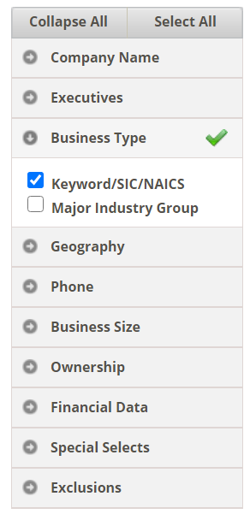

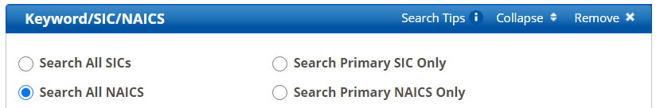
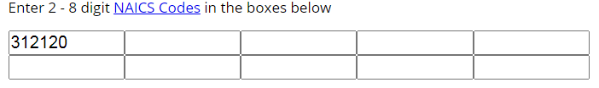


Canadian Business Database
Most comprehensive directory of public & private companies in Canada covering all industries by SIC or NAICS.
1. Click the Advanced Search tab
4. Select View Results button
2. Select search criteria
3. Select & key in relevant industry classification code(s)
NOTE: This database is produced by an American publisher and uses U.S industry codes. Canadian and U.S. NAICS codes should be the same up to 5 digits. Can be variation at 6 or more digits. All companies included in this source are located in Canada.
Notes:
One such directory is the Canadian Business Database.
It is the Library’s most comprehensive directory of companies in Canada covering all industries.
You can search by SIC or NAICS codes, along with a variety of other criteria such as geography, business size and more.
To find all the beer brewing companies in Canada using a NAICS code, select Advanced Search, select Keyword/SIC/NAICS from the business type menu, then key in the 6-digit NAICS code for Breweries - 312120 and select the View Results button.
Keep in mind that this database is produced by an American publisher, so there may be some variation of the NAICS code at 6 digits or more.
To confirm the code number, use the NAICS Codes look-up link in step 3.
If the number is slightly different, but describes the same industry, use the code recognized by the database in order to retrieve a list.
In other words, use whatever number works for your industry in this database.

Slide 26
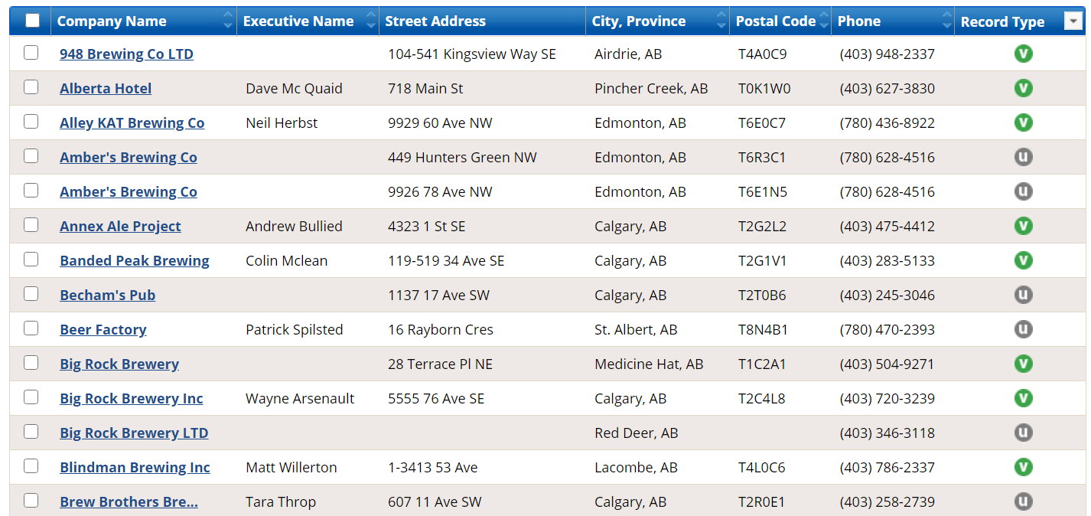

Canadian Business Database
Sample Results (Competitors) List
> 800 companies listed
Click column headings to change sort order
Notes:
The NAICS code search generates a list of over 800 breweries located across Canada. It is possible to change the sort order by clicking the column headings at the top of the list.
What this list does is verify that we’ve picked the right code for the industry.
All the companies listed - such as - Amber’s Brewing Co., Beer Factory, and Big Rock Brewery– sound as though they should belong in the beer brewing industry.
Moreover, we can see that this industry has more than 3 competitors in Canada, so it confirms that this industry meets that requirement of your course report.
The list is also a good way to gauge the size and scope of the industry in Canada.
To view a brief profile of a company, select the company name - in this case, we’ll pick Big Rock Brewery Inc.

Slide 27
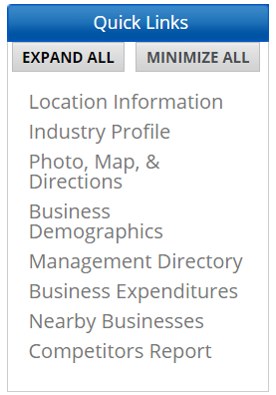
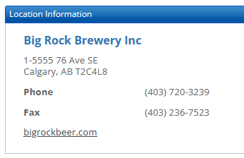
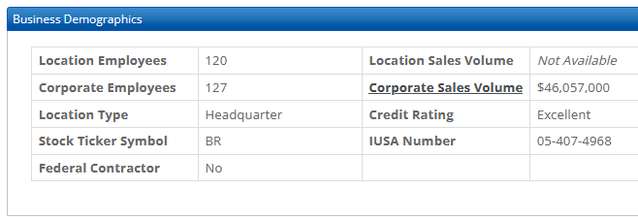
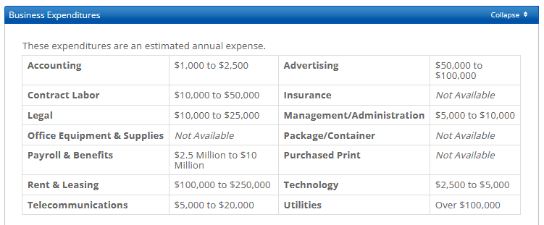
Canadian Business Database
Sample entry: Big Rock Brewery
Notes:
Each company entry in this database includes basic information about the company including location, business demographics, and business expenditures.

Slide 28


Choosing An Industry
Based on Your Company
Start with a company name
Look up the company in one or more company directories/databases
Review the company entry and look for the industry code(s) assigned to that company
Look up the code(s) in the Canadian industry classification manuals to confirm the industry code, name and description
Notes:
Up to this point, we’ve looked up an industry first and then found companies within that industry.
You can also find an industry by looking up a company first.
A lot of students have a company they know they want to focus on for their report, but aren’t sure which industry they belong to.
Instead of looking through the industry classification system to find an appropriate code, you can look up the company in one of the Library’s company directories or databases to see what industry codes those sources have attached to that company.
Once you are presented with some options, turn to the industry classification manual and confirm that the industry code, name and description is the same.
-----------------
Image sources:
Company: https://commons.wikimedia.org/wiki/File:Company_building_icon.png
Cogs : https://pixabay.com/en/gear-gears-graphic-transmission-472008

Slide 29
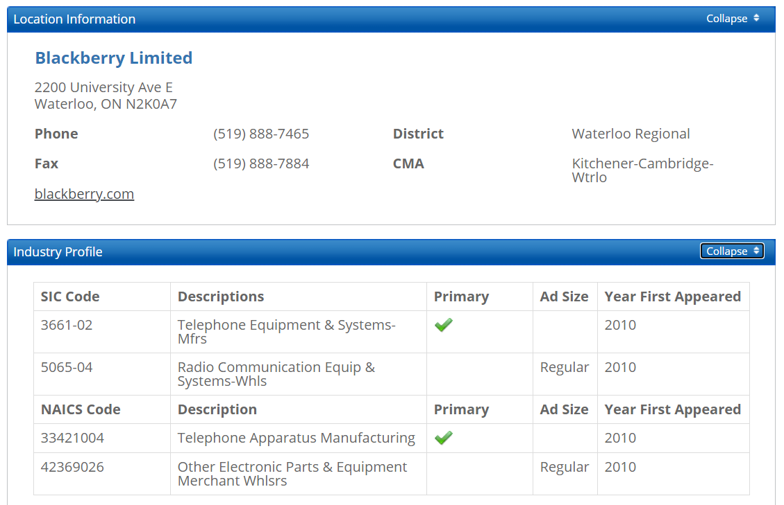


Canadian Business Database
Sample entry - BlackBerry with SIC & NAICS codes noted
Industry
Codes
NOTE: Canadian Business Database uses U.S. SIC and NAICS codes. You should verify the industry codes & descriptions in the NAICS Canada manual and use those in your reports. In this example, the 6-digit NAICS code and description used in this directory match the one in …
NAICS Canada is 334210
Telephone Apparatus Manufacturing
Notes:
For example, if I wanted to find the industry code for the company Blackberry, I could look up the company name in the Canadian Business Database.
The entry includes an Industry Profile section which identifies a few SIC and NAICS codes for the company.
Review the options and pick the NAICS code that is of most interest to you and meets the criteria for this course.
In this example, the telephone apparatus manufacturing industry is suitable for this course, so I would verify that the first 6 digits noted – 334210 - match the industry code in the NAICS Canada manual and I can confirm that it does.

Slide 30

Help! I just found 2 different codes for my company!
Most companies are diversified.
Need many codes to capture all their various activities.
No central agency for assignment of codes.
Sources may interpret a company’s activities differently.
Which code do you pick?
The one that meets the criteria of the assignment and the one you like best.
Notes:
Most companies do many things, so it’s not uncommon for a company to belong to 2 or more industries to better reflect all the activities the company is engaged in.
As mentioned earlier, no central agency assigns the codes to companies, so there can be quite a bit of inconsistency/variation from one source to the next.
Sources may interpret a company’s activities differently – some may think Canadian Tire belongs to the Hardware Store industry, some may think it belongs with Department Stores – neither is wrong, it’s just a difference of opinion or emphasis.
If a sources presents you with a number of industry options for a company, pick the one that fits the criteria for this course – pick a B2C industry and pick one that you like best.
If you can’t find a source that includes an industry you believe your company belongs in, you can go ahead and assign that industry code to your company – just make sure your company actually does what’s described in the 6-digit NAICS code.

Slide 31


Industry Codes Example: Home Depot
Home Depot of Canada is a home improvement retailer that sells building materials, home repair & improvement products, lawn & garden supplies & various installation services.
What NAICS codes would you select given the following options?
Notes:
To illustrate the variety of industry codes one company can have, let’s look at the Home Depot, a home improvement retailer that sells building materials, home repair & improvement products, lawn & garden supplies & various installation services.
I looked up Home Depot in several company directories and found the following NAICS codes for the company.

Slide 32
Home Depot - Possible NAICS Codes
444110: Home Centres
444140: Hardware Retailers
444180: Other Building Material Dealers
444230: Outdoor Power Equipment Retailers
444220: Nursery Retailers and Garden Centres
532490: Other Commercial & Industrial Machinery & Equipment Rental & Leasing
Notes:
All of these industry codes describe some aspect of Home Depot’s activities, but you wouldn’t have to discuss all of these industries in your report – pick the one you like best and pick the one that is B2C focused.
The only code that you wouldn’t be able to do in this course is the last one – 532490 - which is a more business-to-business oriented industry.

Slide 33

When searching with industry codes, keep in mind that …
Companies may have inconsistent industry codes
Companies can have multiple industry codes
Directories, databases and
other business resources
may vary in the use of
classification systems
(e.g., U.S. vs. Canadian
industry codes).
Notes:
To reiterate, companies may have inconsistent industry codes and companies can have multiple industry codes.
Don’t’ worry about these discrepancies and variations in industry codes.
If a code describes what your company does, then you can say it’s in that industry.
Just make sure it comes from the NAICS Canada manual from Statistics Canada.

Slide 34

Choosing the Right Company
Canadian-Based & Publicly Traded
Must have a head office in Canada
  this alone does not guarantee that it meets the company requirements
SHOULD be an active, listed (public) company for at least the last four consecutive years
CAN be a multinational company or a subsidiary of a multinational, but the Canadian entity should be publicly traded (e.g., HSBC Bank Canada)
Notes:
For your course report, you will also have to focus on a Canadian company within your industry.
The company must have a head office in Canada. The company doesn’t have to originate in Canada, it simply has to have a geographic presence in Canada.
The company should also be currently active and publicly traded. Public companies have a responsibility to their shareholders to provide updates about their finances and business practices.
As a result, information on these types of companies is readily available
The public company you pick, must also have been listed for at least the last four consecutive years as you will be assessing several years worth of the company’s financial statements.
In other words, if a company is public this year, but wasn’t last year, it is not eligible to be the company you focus on for this course. The company should be continuously listed for at least the past four years.
The company you pick can be a multinational company or a subsidiary of a multinational, but the Canadian entity should be publicly traded.
In other words, if HSBC Bank and HSBC Bank Canada are both public, you should pick HSBC Canada because you need to use Canadian corporate data and financials which is typically only reported in Canadian filings.
In other cases, the Canadian entity may not be public, in which case the company would be ineligible for this course.
For example, Home Depot Canada is the Canadian subsidiary of the US based Home Depot. The Home Depot in the United States is public, whereas Home Depot Canada is private, so it cannot be used as the main company for your report.
The competitors in your industry can be private or public, only the company you focus on in your report has to meet the criteria outlined in this slide.

Slide 35

Company Suggestions
  Try to focus on a company that is well known and has a national presence
Focus on a company where you have a confirmed contact
Avoid a private company, a holding company, an income fund company & public institutions (e.g., universities)
Confused? Use Mergent Online (Basic), Nexis Uni (Dossier) and/or Factiva (Companies/Markets) to confirm company type and structure.
Notes:
Other company suggestions to keep in mind.
Focus on a company that is well known and has a national presence, as more information is likely to be available
Focus on a company where you have a confirmed contact – a friend or relative in a company may be able to provide answers to questions that are not widely publicized
You should also avoid a private company like a start-up or sole proprietorship. Privates have no legal obligation to disclose anything about their finances or performance, so information is challenging to locate.
Also for this course, avoid doing a holding company, an income fund company or a public institution such as a university
If you’re unsure about your company type or structure, the Library subscribes to several company databases (such as Mergent Online) that can help you confirm whether the company you are considering meets all the criteria for your report.

Slide 36
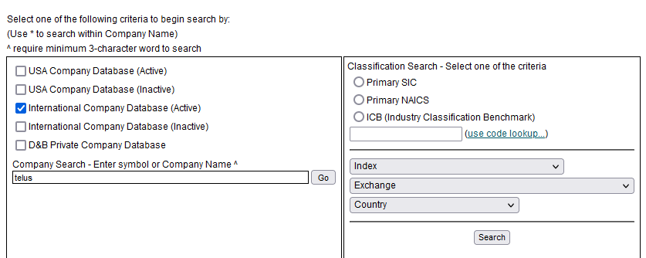


Mergent Online
Includes publicly traded companies worldwide.
Search by company name, industry codes, country & more
International Company Database (Active) includes current publicly traded companies in Canada (& elsewhere).
Notes:
Mergent Online is a company database that includes both active and inactive public companies from around the world.
You can search for companies by name, by industry code, index, exchange or country.
In this example, we’re going to search for the company Telus by selecting International Company Database (Active) and entering its name in the search box.

Slide 37
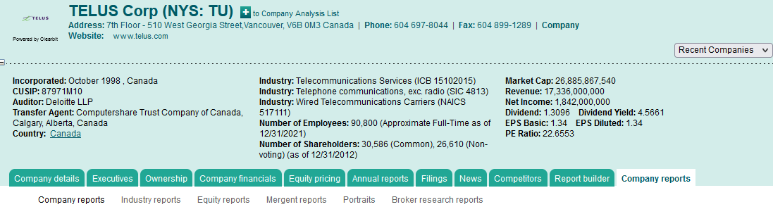
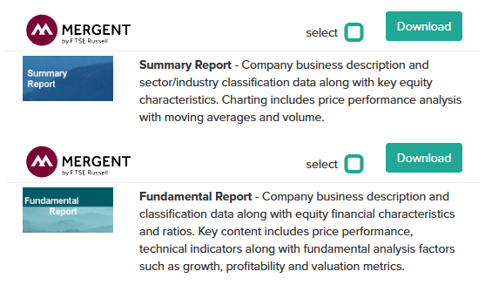
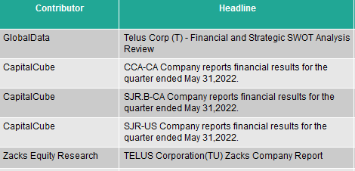



Mergent Online Company Profile e.g.,TELUS Corp – includes Company Details, Financials (in Excel),
Reports (Annual, Broker) and more.
Notes:
Mergent Online includes a profile for TELUS Corp
Reviewing the company profile and information contained in tabs such as Company financials, Annual reports, Filings and Company reports confirms that Telus is a currently active, public company in Canada that has been listed for several years.
Although some of this information is freely available on a company’s website, the Library’s subscription databases extract and compile information from these sites for more user-friendly research options – for instance, all financial information for this and other public companies can be downloaded to Excel, facilitating analysis and comparisons between companies.

Slide 38

Company Annual Reports
CAN be an excellent source for company financials, plans, mission statements, etc.
Find annual reports (& other company documents and financials) via the company website, SEDAR or Mergent Online
Notes:
A key document for public companies is the annual report which CAN be an excellent source for company financials, plans, mission statements, and more.
You can find annual reports & other company documents & financials on the company website or through databases such as SEDAR and Mergent Online.

Slide 39

Use Company Annual Reports With Care!
Don’t expect the annual report to answer all of your marketing research questions (advertising strategies, target markets, etc.)
Don’t expect an annual report to be objective! They are promotional tools
  good news stories!
  will downplay poor financials and bad ideas
Notes:
Although annual reports can provide great insight into a company, you should be aware that it won’t answer all of your questions and it won’t be the most objective report on the company.
These reports are promotional tools that emphasize good news stories and downplay poor financials and bad ideas.

Slide 40
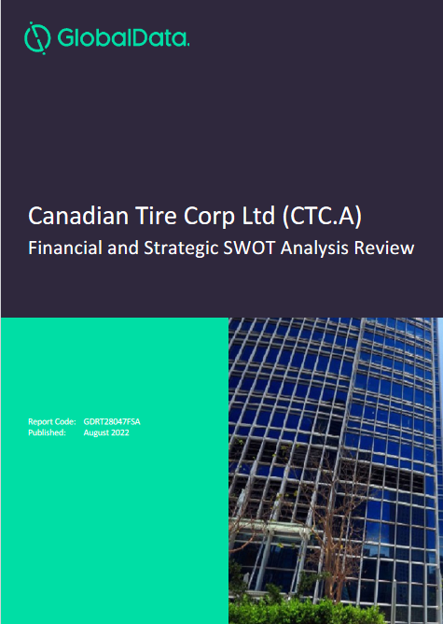
Investext via Mergent Online
Includes analyst reports on companies worldwide
Reports can include ...
  company overview
  key facts
  history
  major products & services
  financial analysis
  SWOT analysis
  top competitors
  company view
  and more …
Notes:
You should supplement your company research with reports produced by analysts who work outside the company to get a more critical appraisal of the company’s financials and its performance.
The Library subscribes to several databases that include such reports including Investext within Mergent Online.
The Investext tab contains full-text research reports on global companies (and industries) written by analysts at leading investment banks, brokers and independent research firms.
Research contributors include BNP Paribas, Credit Suisse, CIBC World Markets, HSBC Global Research, Morningstar, Wells Fargo and hundreds more.
This slide highlights a report on Canadian Tire produced by GlobalData, a data analytics and consulting company.
It includes a SWOT analysis and other evaluative information about the company.
Unlike company annual reports, analyst reports are not typically available on the open web, so make sure you take advantage of these reports by accessing them through the Library’s subscription databases.

Slide 41
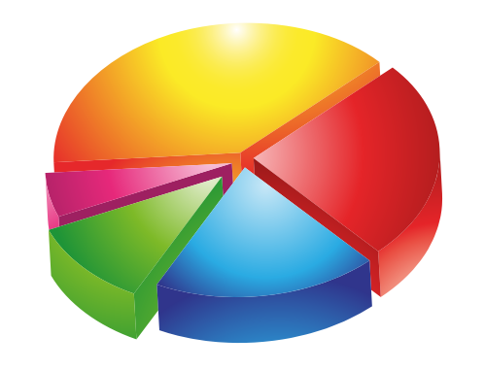
Market Share
current Canadian market share
top 3 companies in your industry (based on sales/revenues) & their corresponding market share percentages & values; your company of choice may or may not be in the list.
companies can be public, private, Canadian, or international
top 3 companies will not typically represent 100% of the industry
You need to find …
Notes:
Current Canadian market share is another component you need to include in your course report. You are expected to identify the top 3 companies in your industry based on sales or revenues along with their corresponding market share percentages & values.
Your company of choice doesn’t have to be one of the top competitors and those companies that are in the list may be all public, all private or a mix of both.
The top three companies will not typically represent 100% of the industry.
There are likely many more competitors in the industry, but they do not need to be identified in your course report.
----------------
Image source:
https://freesvg.org/img/diagramma-a-torta-2.png

Slide 42

Market Share Table Example
Breweries in Canada 2022
Company Name | Market Share % | Value of Market Share*
Labatt Brewing Co. Ltd | 45% | C$3.5 billion
Molson Coors Canada | 34% | C$2.7 billion
Sleeman Breweries Ltd. | 5% | C$393 million
* Value of market share is based on industry sales or revenue not on the company’s overall sales or revenue. Value of market share was calculated based on Canadian beer industry revenue of C$7.86 billion.
NOTE: The numbers in this table are fictional and are being used for illustrative purposes.
Notes:
Here is an example of the elements you should include in a market share table for your report.
One column should indicate the names of the companies in order of largest to smallest market share.
The second column should indicate the market share percentage (based on the industry size) that is associated with each company.
The third column needs to show the value of the market shares translated into sales or revenue of the industry.
To be clear, you are calculating this based on your industry s sales or revenue not on the company’s overall sales or revenue.
In this example, the top 3 companies comprise 84% of the market ($C6.60 billion). The remaining 16% ($C1.26 billion) is comprised by other companies in the industry.

Slide 43

Finding Market Share
Market share for Canada can be difficult to locate
No easy answers
Like putting together a puzzle
  Have to piece together information from a variety of sources
  You may not be able to find all the pieces!
Notes:
Market share for Canada can be difficult to locate.
You’re also not likely to find a market share table with all the required elements, like the one in the previous slide.
Many companies don’t publicize their market share for competitive intelligence reasons, so you may have to create a table based on information you piece together from a variety of sources.

Slide 44

Sources of Market Share
IBISWorld (database) – see Major Companies & Key Statistics sections in Canadian industry reports
Passport (database) – see Competitive Landscape or Market Data sections in industry reports
Business Source Premier (database) – check Industry Profiles for Canada
Mergent Online (database) – select Investext tab and search for reports by company/keywords
Newspaper & Magazines Articles
  Factiva (database)
  CPI.Q (Canadian Periodicals Index Quarterly) (database)‏
Remember to look for
Canadian content.
Notes:
The Library subscribes to several databases that can contain market share information.
Some of the most promising ones are noted on this slide – IBISWorld and Passport are probably your two best bets.
When you find market share, make sure the content is Canadian - look for the word Canada in the table title, report or article to confirm the location of the market.
----------------
Image source:
Maple leaf - https://upload.wikimedia.org/wikipedia/commons/e/ee/Stylized_Maple_Leaf.jpg

Slide 45

Is this Market Share Table Enough?
Top Marshmallow Brands 2002
Jet Puffed 41.2%
Campfire 9.0%
Jet Puffed Funmallows 3.6%
Fireside 2.2%
Other 39.0%
Source: Snack Food Weekly, June 2002, p. 23.
Found in Market Share Reporter, 2004
Notes:
Here’s a sample market share table for Top Marshmallow Brands 2002.
Is this market share table enough for your course report?
The short answer is no, but why?
Is this a market share table of companies or brands?
The table title indicates brands, but you need company market share for this course, not brand market share.
All the brands listed may actually be produced by the same company, and that’s not what is needed.
Is this market share for Canada?
Probably not. Canada is not mentioned in the table.
Many market share sources are produced by American publishers, so when geography is not specifically noted, it’s generally assumed that the data applies to the US market.
If you’re not sure of its geography, investigate the source of the information more thoroughly.
What about currency?
Is 2002 market share too old for this course?
Yes, it is. You need to find something more recent, preferably sometime in the last two years or so.

Slide 46

Things to Watch Out For …
If the word “Canada” doesn’t appear in the source, the data is probably U.S.
Is the source listing brands or companies? Are there really just a few companies fronting a large number of brands?
Notes:
If you do find market share in a published source, make sure it is Canadian and make sure that it is company market share.

Slide 47

Calculating Market Share
Can’t find your market share in a published source?
Try a company contact. If your contact says the company doesn’t know, ask someone else.
Estimate: calculate a very rough estimate using all the information you’ve gathered from primary and secondary sources
Notes:
If you can’t find your market share in a published source, you can try a company contact or you may have to estimate Canadian market share based on everything you’ve learned about the industry and its companies from your research.
An estimate that shows your calculations and includes supporting documentation may be the best that you can do, and that’s okay.
Often times the information you need won’t be available, so you have to deduce what you can from the sources that are accessible to you.

Slide 48
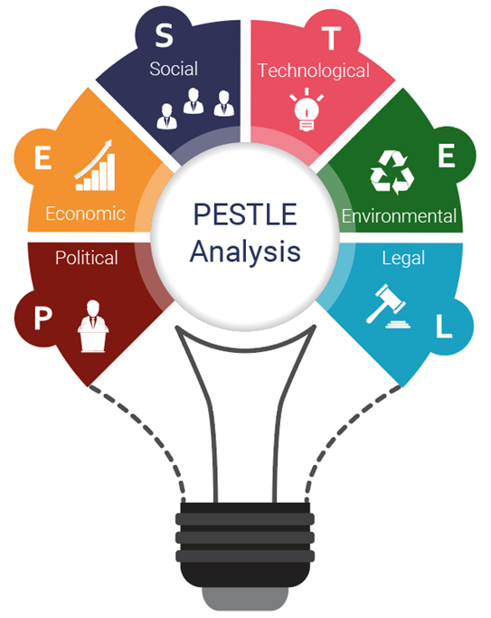

Environmental Trends Analysis
You need to discuss trends in the industry that are, generally speaking, impacting companies in the industry.
Environments that should be discussed include:
                Political
                Economic
                Social
                Technological
                Environmental
                Legal/Regulatory
Sources useful for a PESTEL analysis are noted on the following slides …
NOTE: a coloured letter indicates good coverage of that environment, e.g., = economic
PESTEL
Notes:
Your report will also include a PESTEL analysis on your industry which involves discussing at least one opportunity and one threat in each of these six environments.
Political
Economic
Social
Technological
Environmental
Legal or Regulatory
The Library subscribes to several databases that should help you address the impacts that trends in these environments have on your industry and the companies within it, although some will cover certain environments more thoroughly.
The next few slides highlight some key resources and their coverage of these environments.
----------------
Image source:
PESTEL - https://www.ibisworld.com/industry-insider/how-to-use-industry-research/how-to-use-ibisworld-research-in-a-pestle-analysis/

Slide 49
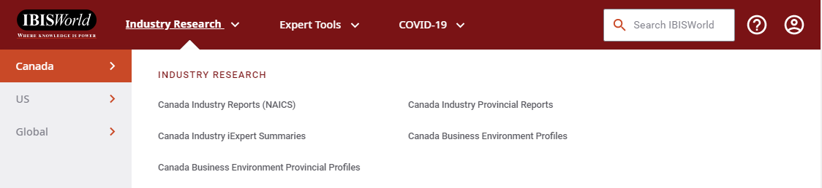
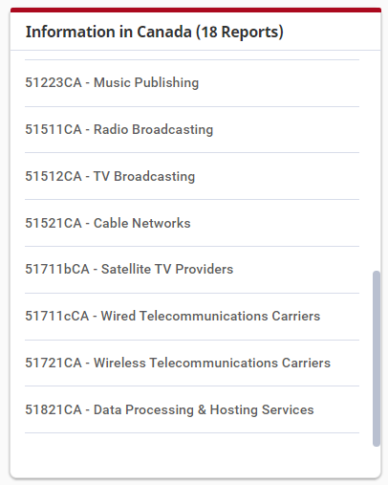
IBISWorld
Includes Industry Reports for Canada
PESTEL
wireless canada
Browse or Search
for industry reports
Includes COVID-19 impact and assessment tools plus insights.
Includes over
1,700 U.S.,
430 Canadian,
100s of provincial
& 74 global industries, many at the 5-digit NAICS level.
IBISWorld Article:
How to Conduct a PESTEL Analysis
Notes:
IBISWorld is one of the largest providers of industry information.
Their database includes over 400 current Canadian industry reports at the 5-digit NAICS code level.
Everyone in this course should be able to find a report on their industry in this database.
All 6 PESTEL environments are addressed in relatively lengthy industry reports produced by IBISWorld.
You can browse a list of Canadian industry reports, or you can search for your keyword(s) across all the reports.
In this example, we’re looking for a report on Wireless Telecommunication Carriers in Canada.
We can browse the menus to locate the report, or we can enter relevant keywords into the search box.

Slide 50
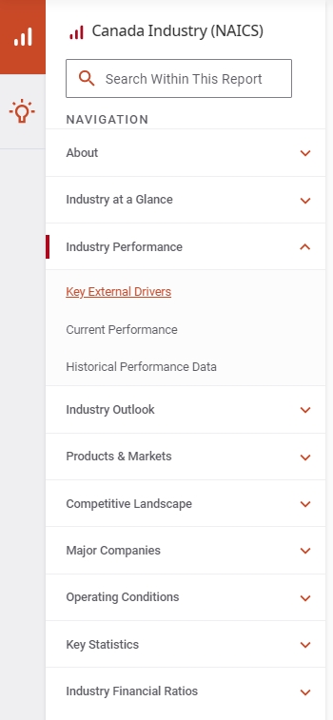
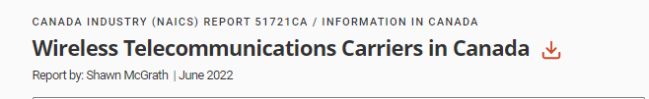
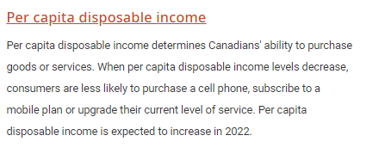
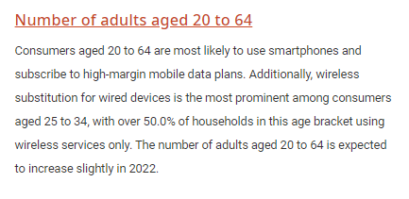
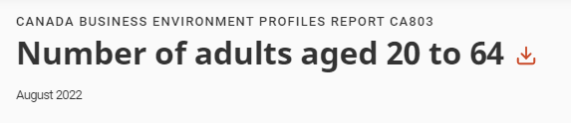
Sample IBISWorld Industry Report
(includes
a SWOT)
Points are specifically related to industry
Industry reports are approx.
30-40 pages long with content structured into these chapters
(includes market share)
(includes industry revenues over time)
Notes:
All IBISWorld industry reports are structured the same way and have a standard table of contents.
All sections of the report should help with your PESTEL analysis, but some key areas to explore include
Industry at a Glance, which contains a SWOT analysis on the industry
Major Companies which includes market share information
and Key Statistics which provides current and historical data on the industry.
In particular, Key External Drivers within the Industry Performance section identifies issues and factors that specifically affect the industry.
The points noted, lead to a report with further information and analysis on that topic.
IBISWorld is one of the few sources that make a clear connection between an environment and its effects on a specific industry.

Slide 51

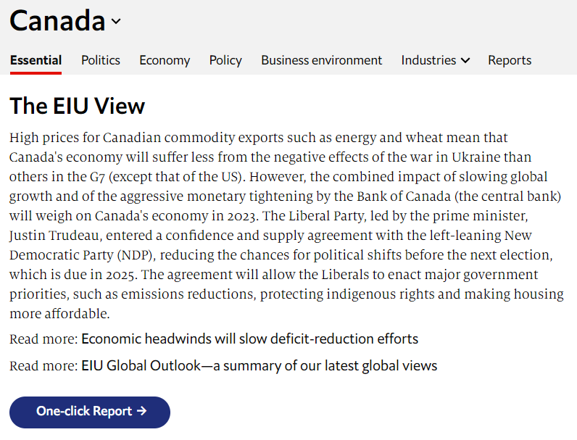
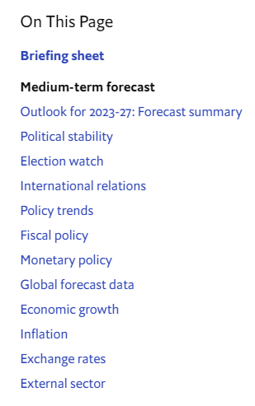
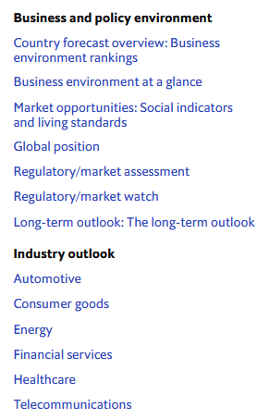
EIU Viewpoint
Includes worldwide country analysis
PESTEL
Pick Canada from the Geography menu
NOTE:
Content is not always industry specific.
Notes:
Another database worth exploring for this course is EIU Viewpoint, a database produced by the Economist Intelligence Unit, an organization known for its global country analysis and research.
Viewpoint is updated regularly and is especially useful for the political, economic, and legal environments.
Select the Geography menu and pick Canada to view all the EIU analysis, reports and data available for Canada in Viewpoint.
Although the content may not necessarily be specific to your industry, you may be able to extrapolate and apply the insights you discover to your particular industry.

Slide 52
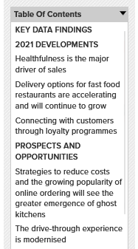
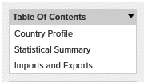

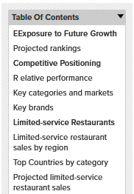
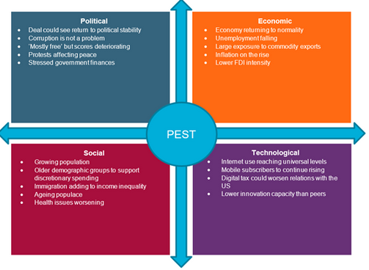

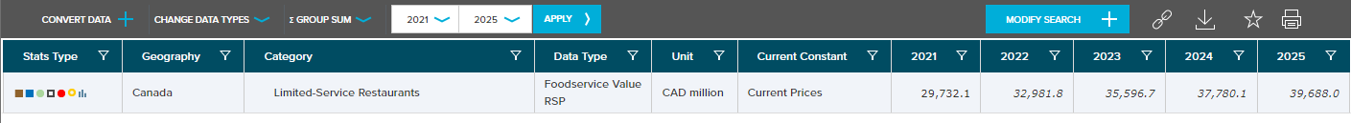
Passport
Includes reports and statistics on industries, countries, consumers and companies worldwide
PESTEL
Sample reports and statistics
consumer lifestyles canada
Browse menus
Topics covered …
Home Life
Eating Habits
Working Life
Leisure Habits
Health and Wellness
Sustainable Living
Shopping
Spending
Technology
Notes:
Passport, produced by Euromonitor International, is a global market information database that includes worldwide reports and statistics on industries (mostly B2C), economies (or countries), consumers and companies.
Browse the menus in the Passport toolbar or search by keyword to find relevant reports and statistics.
The Consumer Behaviour in Canada report should help everyone with the social environmental trend analysis for their industry.

Slide 53
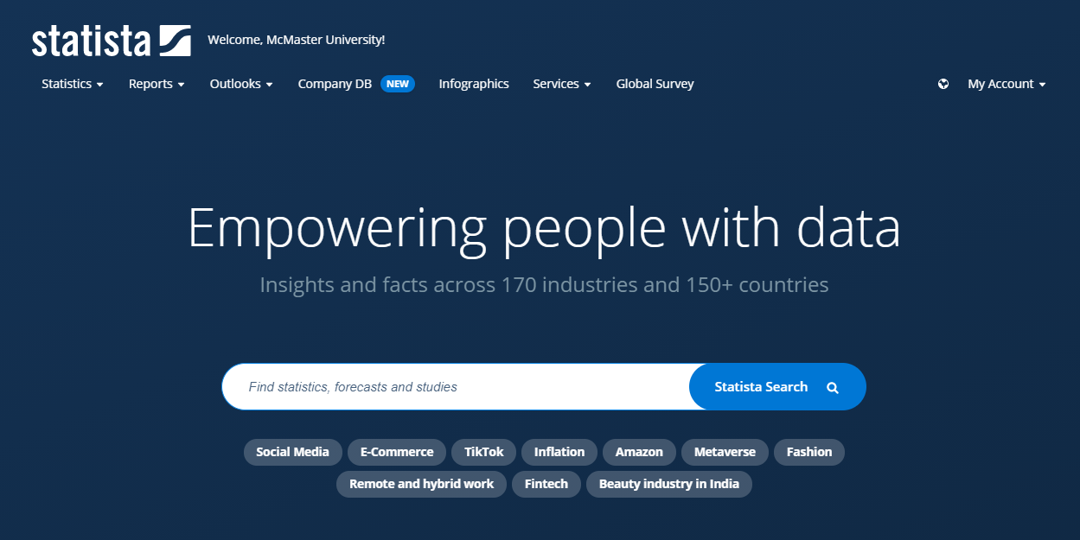
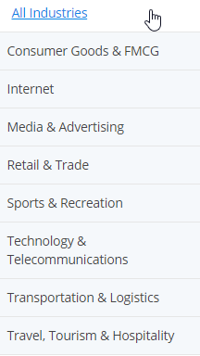
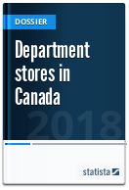
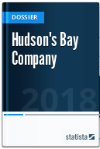
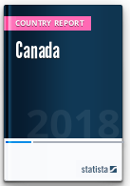
Statista
Includes millions of statistics & reports on thousands of topics from a variety of sources. Worldwide coverage.
PESTEL
Browse or Search for country, consumer, company & industry info. Search results can be limited to Canada.
Sample Reports
shopping habits canada
Notes:
Statista is a database that includes millions of statistics and a variety of reports on thousands of topics from a number of sources.
You can browse the menus or search for worldwide country, consumer, company and industry reports and information.
Statista is useful for researching almost all environments for your PESTEL analysis.

Slide 54

Canadian Trade (or Industry) Associations
Often provide statistics & identify current issues and trends in a particular industry
PESTEL
Use the Associations Canada (directory)‏
  Available ONLINE via Canada’s Information Resource Centre database
Try Google (or another web search engine)
  - Type the words Canada and association, along with terms that describe your industry
Notes:
One of the best and most underutilized sources for industry information are trade association websites.
Almost every industry and profession have an association or organization that supports its members and advocates for its interests.
Some associations are international, others are regional or national in scope, and others can be local.
The Canadian Marketing Association (CMA) and the Western Canadian Shoe Association (WCSA) are two such examples.
Associations often provide industry statistics and identify current issues and trends in a given industry.
In particular, associations are especially familiar with the legal and regulatory issues facing the industry and are often the ones lobbying governments about these issues.
How do you find a trade association relevant to your industry?
You can search the Associations Canada directory, or you can simply search the Internet for the words Canada, association and some industry keywords to locate a relevant association.
Although you may not be able to locate an association that exactly matches the activities represented by your industry code, you may find one that is in the same sector and still applicable.

Slide 55
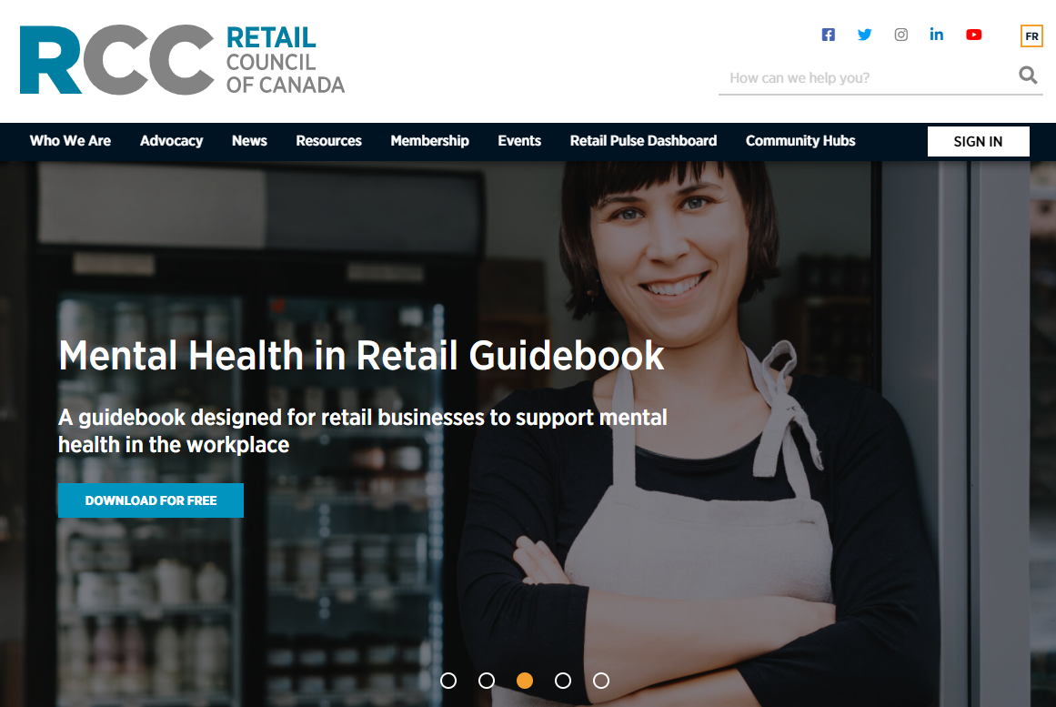

Trade (or Industry) Associations e.g., Retail Council of Canada
Visit or follow the association’s
social media channels for
current info & trends in the industry.
Resources section usually includes latest statistics and research on the industry across Canada.
NOTE: Some association content may only be available for a FEE or for members only.
Advocacy & News sections typically address issues related to that industry, particularly legal and regulatory ones.
Notes:
Here’s an example of an association for the retail sector – the Retail Council of Canada - which has links and info that could apply to almost all retail industries.
Topics that may be addressed at association websites include …
finance and tax
labour
legislation and regulations
product safety
store operations
health and wellness
sustainability
Keep in mind that some content at association websites may not be completely open and free to the public.
There may be a fee involved, or you may be able to gain access to the content by contacting the association directly.

Slide 56
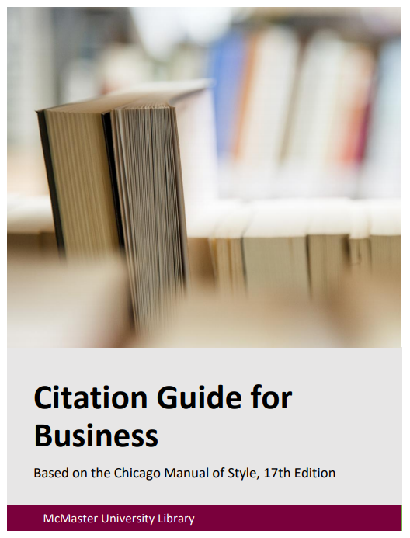

So How Do You Cite All this Stuff?
Sample Notes & Bibliography included at end of guide!
Use the Citation Guide For Business exactly
  Based on Chicago Manual of Style, 17th ed. (available online)
Capture references as you research
Do not copy URLs from the address bar of your browser when using library databases – the links may not be stable! Use permalinks (if available) for library database content.
Don’t leave it till the last minute!
Notes:
Once you’ve done all your research, you’ll need to put it all together in your reports.
For this course, you’re expected to format your report and cite your sources according to the Citation Guide for Business, a guide that has specifically been developed for the DeGroote School of Business and which is based on the latest edition of the Chicago Manual of Style.
As you do your research, collect the full details of your sources so that you have all the necessary elements required to cite them correctly.
Resist copying and pasting only the URLs of sources as they may not work at a later date and you may not be able to locate the source again.
To avoid this disappointment and frustration, be thorough about recording citation details as you do your research.
Examples of how to cite many of the resources discussed in this session are included in the Citation Guide for Business.
A sample Notes and Bibliography page is also included at the end of the guide. Please note, that you are required to use ENDnotes, not FOOTnotes in your course reports.

Slide 57






Research Help
E-mail: library@mcmaster.ca
Phone: 905-525-9140
  ext. 22077 Mills Service Desk
Face to Face:
  Drop by the Mills Service Desk (1st floor), Monday to Friday
Live Chat/Text: https://library.mcmaster.ca/justask/
Notes:
Are you still with me? Feeling overwhelmed, confused?
When in doubt, go the Library! We are here to help.
If you have questions about your research or about access to resources, select the Get Help option from the toolbar on the Library’s website .
Several help options are displayed on the Get Help page, including email, phone, face-to-face and live chat.
It’s best to check the website for latest service hours and contact details.
Thank you for your attention and good luck with your research!

